Slide 1
X-ray tomography at GTK
What is the new device and what can it do?
XCT launch meet 9.11.2017

Slide 2
X-ray tomography - principles
Sample is rotated and projections are recorded from all sides
Projections can be reconstructed into a 3D absorption coefficient map
Essentially a 3D density map
Non-destructive
© Samuli Siltanen

Slide 3
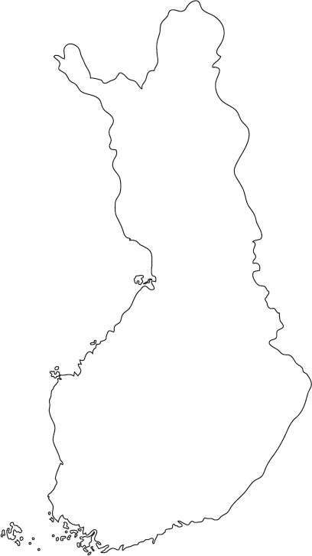
Existing tomography devices in Finland
Stora Enso, JYU and UTU were first
Now devices at least in
Helsinki
Tampere
Kuopio
Oulu
6 Bruker Skyscan (1072, 1172, 1272)
3 Zeiss Xradia (microCT-400, nanoCT)
Several PET/CT devices

Slide 4
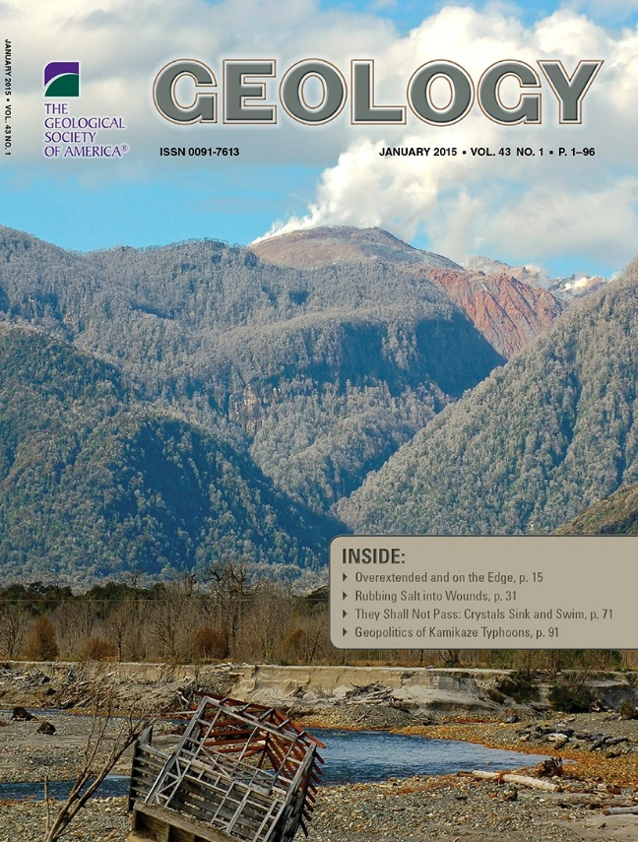
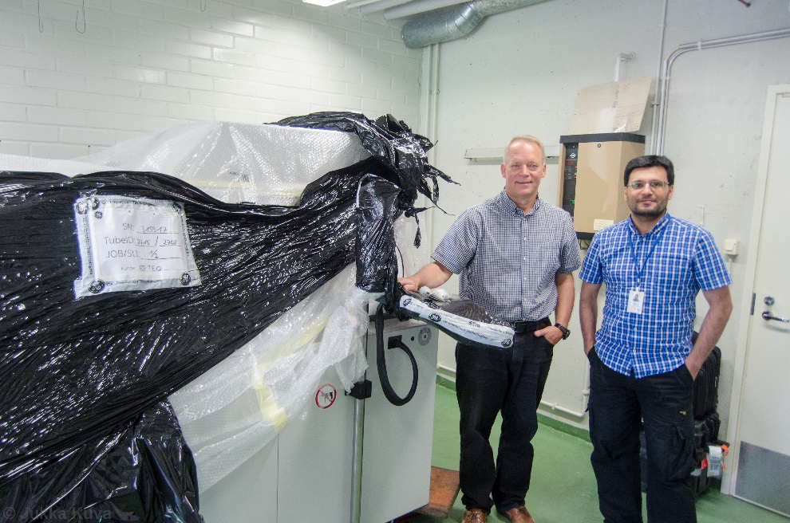
How and why was the GTK device acquired?
2013 Sayab Muhammad joins GTK
Idea about investigating rock morphology with XCT
First sample scanned at Helsinki University
Sayab, et al., High-resolution X-ray computed microtomography: A holistic approach to metamorphic fabric analyses. Geology 43 (1): 55-58 (2015)
2014 a talk about using XCT to decipher microstructures
Interest within GTK
Academy application within the RAMI network
2015 funding granted
2017 device installed

Slide 5
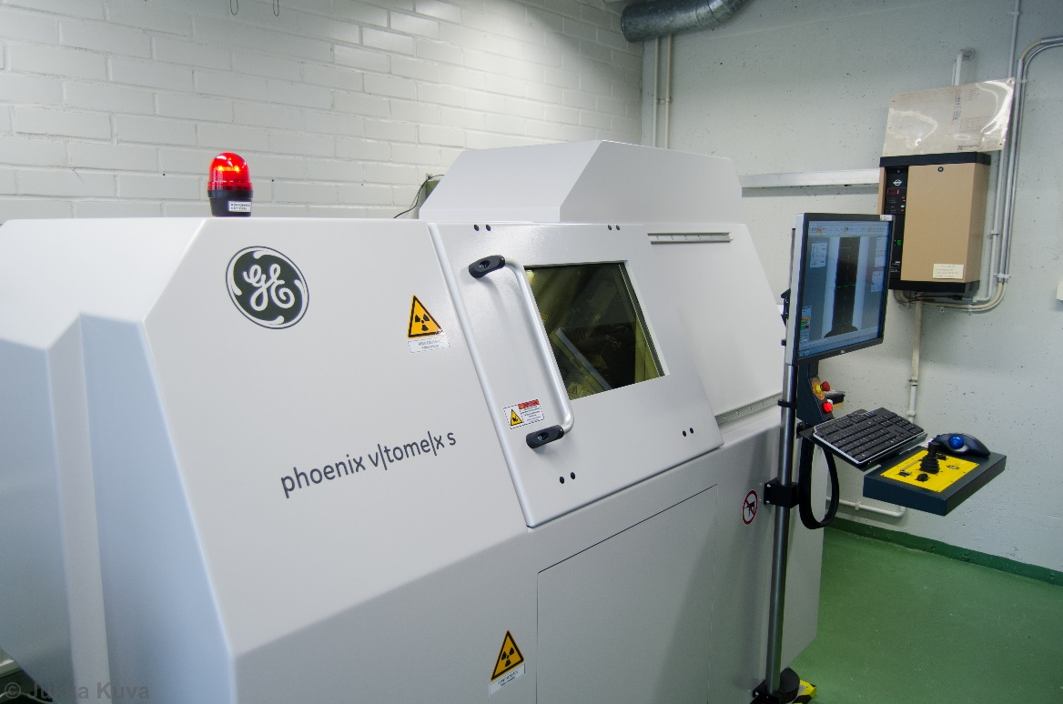
GE phoenix v|tome|x s 240
Manufactured in Wunstorf, Germany
240 kV / 320 W microfocus tube
Most powerful in Finland!
180 kV / 15 W nanofocus tube
400×400 mm² 4 Mpix detector

Slide 6
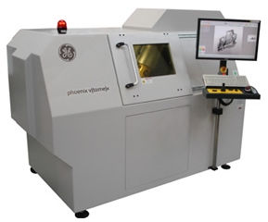
GE phoenix v|tome|x s 240
240 kV / 320 W microfocus tube
Resolution up to 5 μm
Allows imaging of complete drill core samples
180 kV / 15 W nanofocus tube
Resolution up to 900 nm
400×400 mm² 4 Mpix detector
Max. sample size 26×41 cm² / 10 kg
FOV width = 2000 pix
fast|scan module
Along with high power enables short scan times when necessary (<30 min)

Slide 7
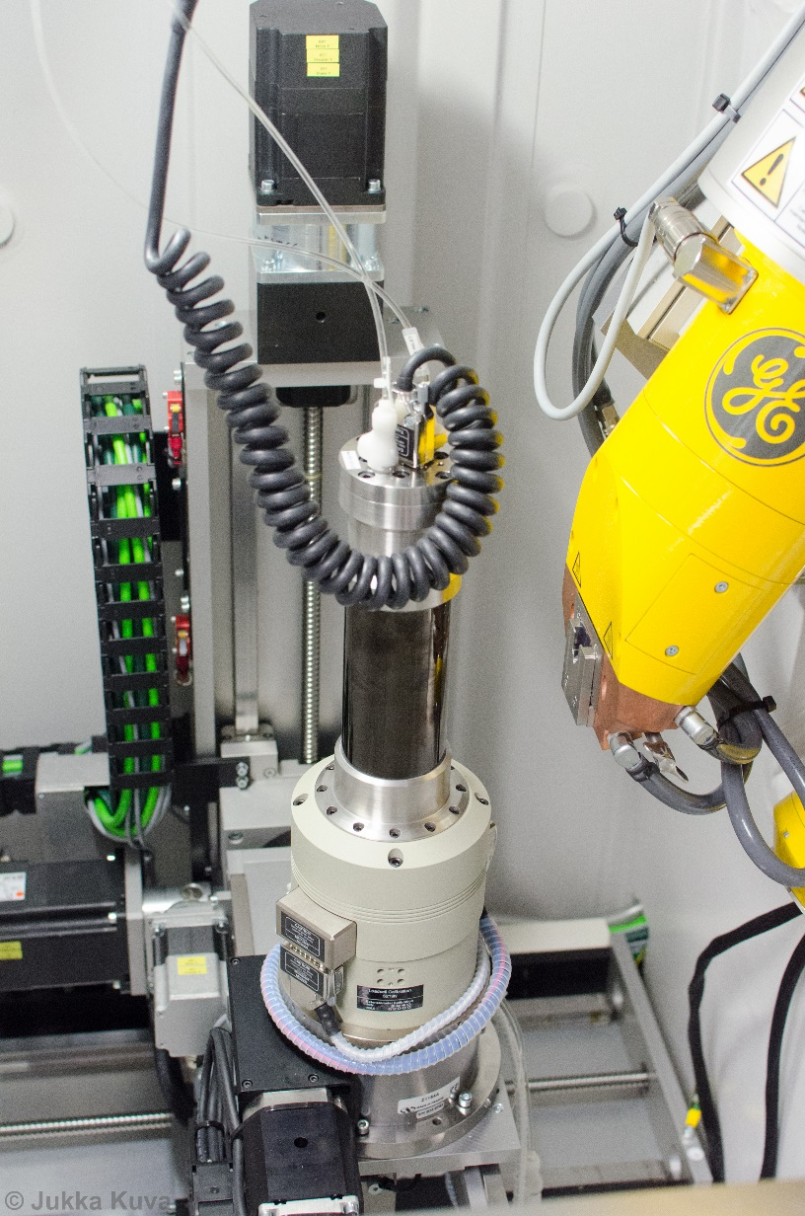
Deben sample stage
Compression and tension
Force up to 5 kN
Displacement up to 10 mm
Cooling and heating
Peltier elements at both ends of the sample
Elements controlled independently
-20 to 160 °C

Slide 8
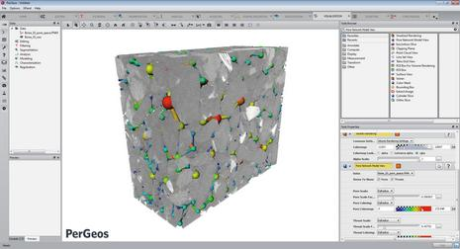
FEI PerGeos
Powerful tool for image processing
Noise filtering
Segmentation
Watershed reduces operator-dependency
Recipes increase efficiency
Analysis
Grain orientation
Pore size distribution
Visualization

Slide 9
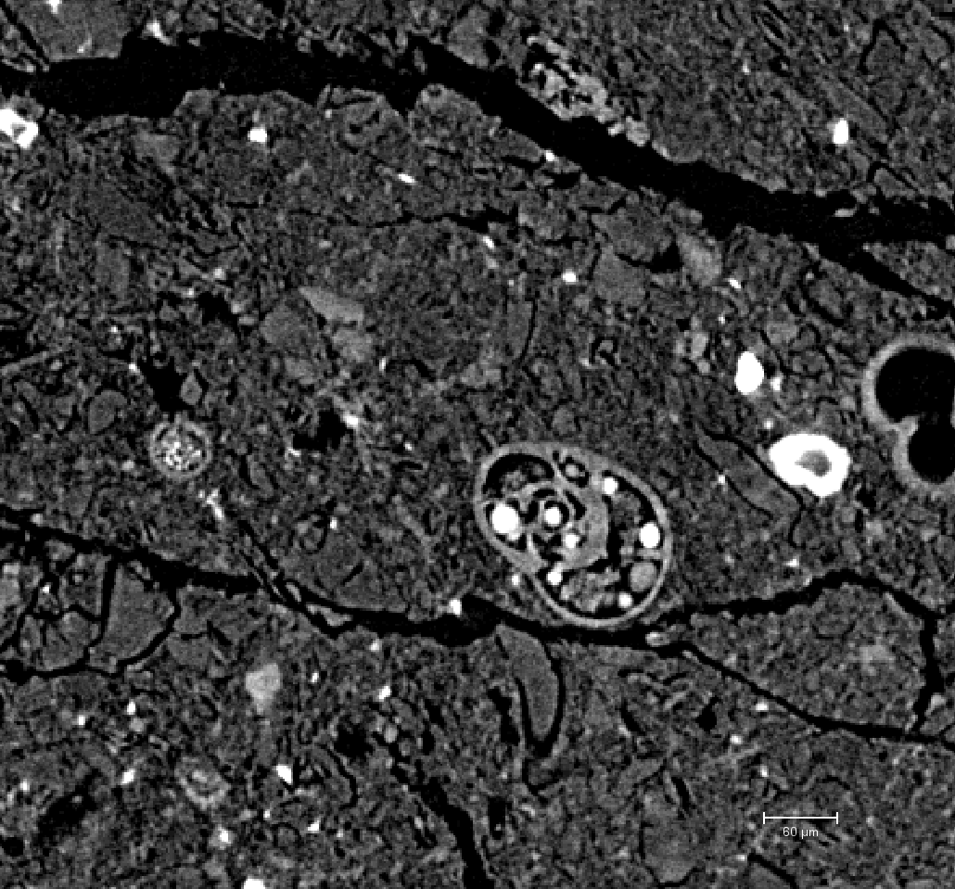
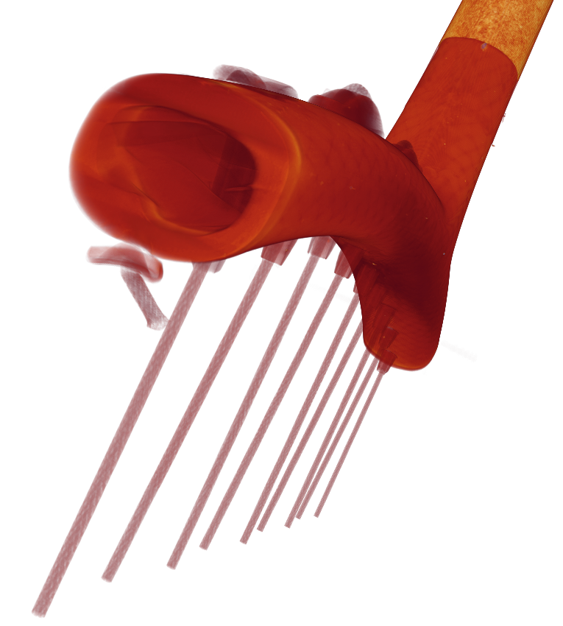
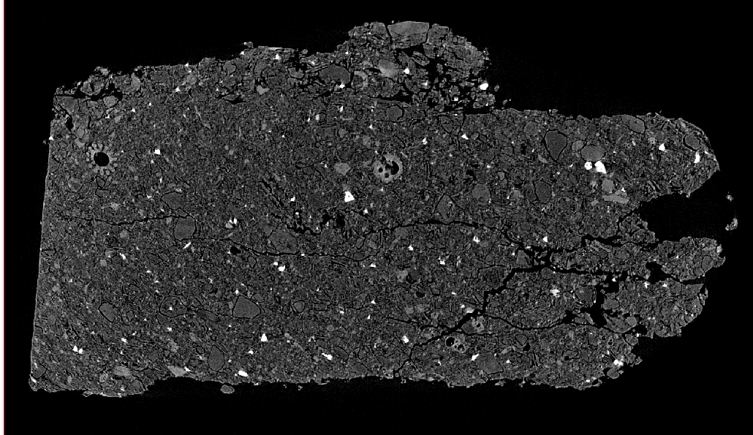
Sample sizes
Diameter 1,8 mm for best resolution
Max. Diameter 26 cm and height 41 cm
Everything in between!
26 cm
1.8 mm

Slide 10
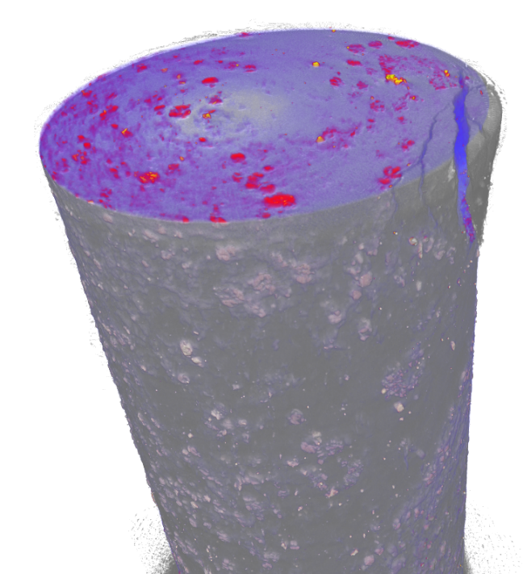
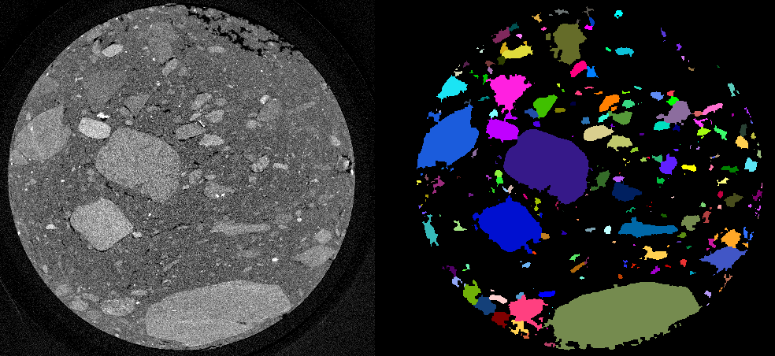
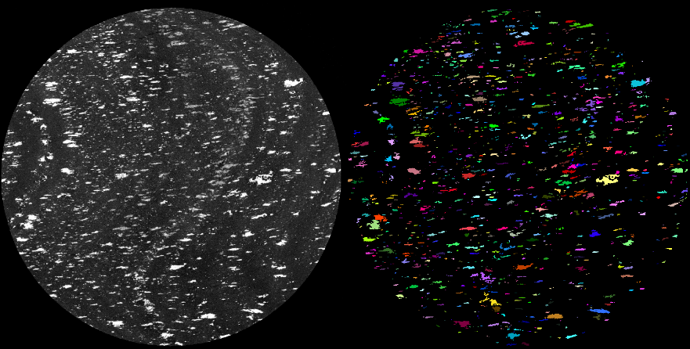
Applications
Grain orientations of gravel samples through the sample holder
Orientation analysis for high density inclusions
Lake sediment layer analysis through the sample holder
Non-destructive imaging of invaluable samples
Before – after analysis for rock fractures
3D shape inspection

Slide 11
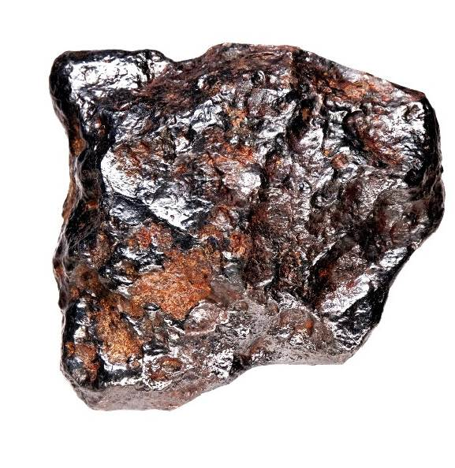
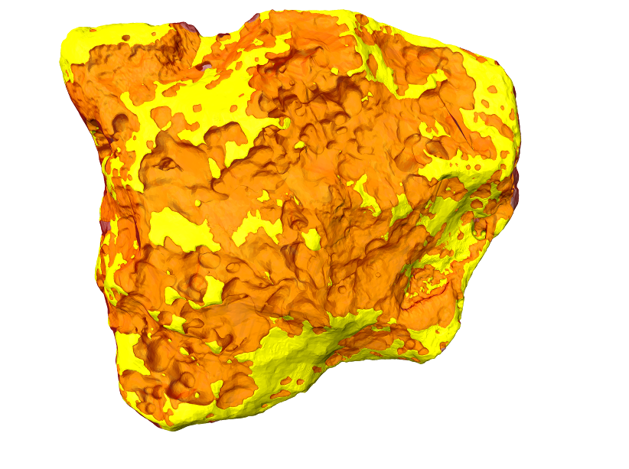
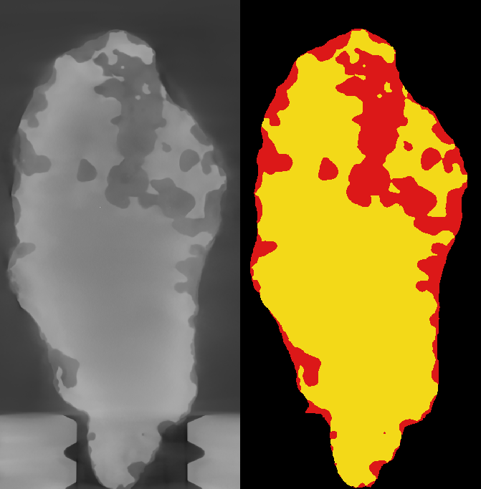
Case: Lieksa iron meteorite
First iron meteorite found in Finland
Max. thickness 6,6 cm, mostly Fe-Ni compound
220 kV / 48 W: Inner structure along with volumetric fractions of iron and silicate phases – unattainable by any other method

Slide 12
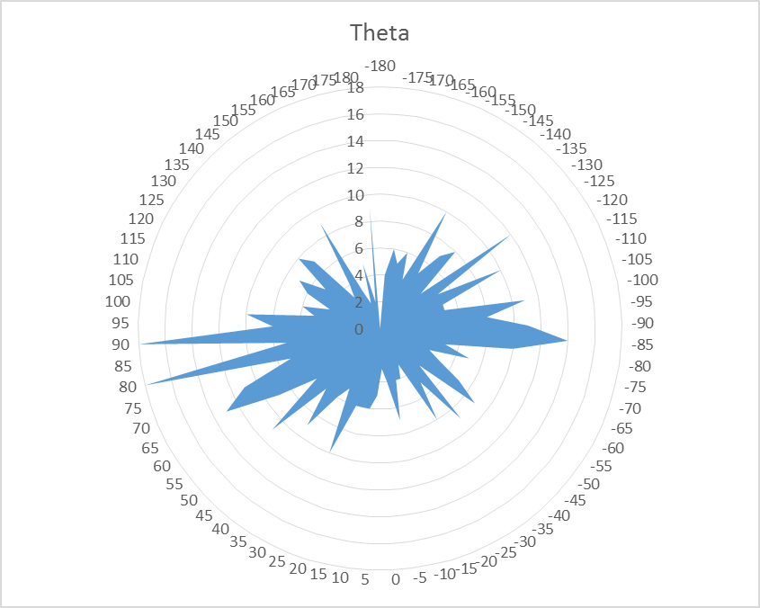
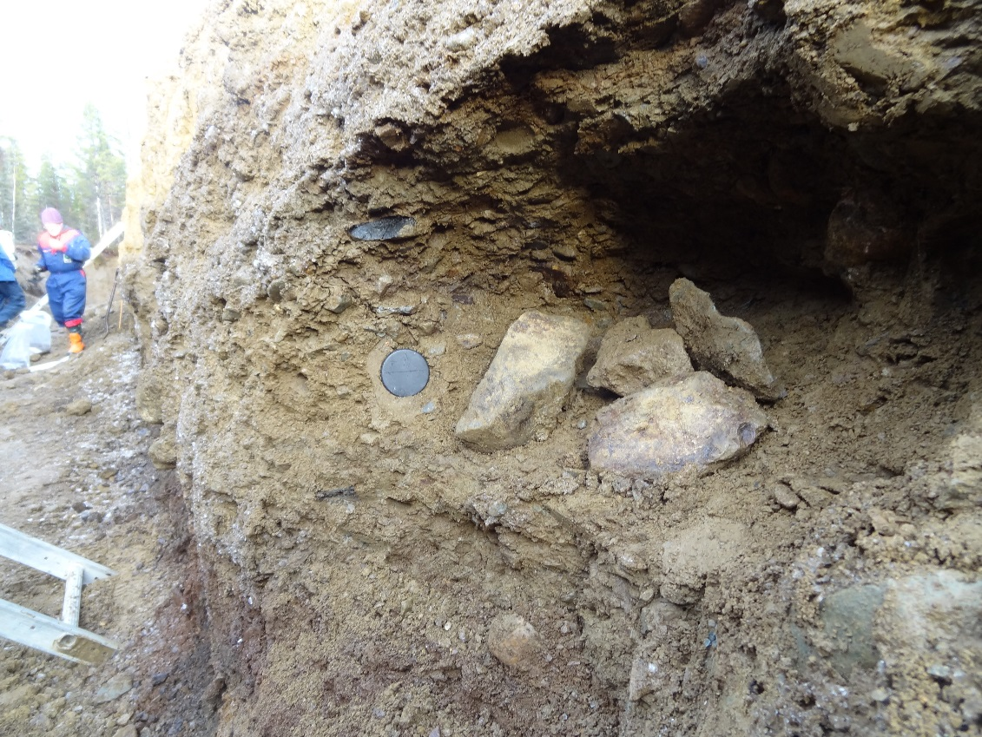
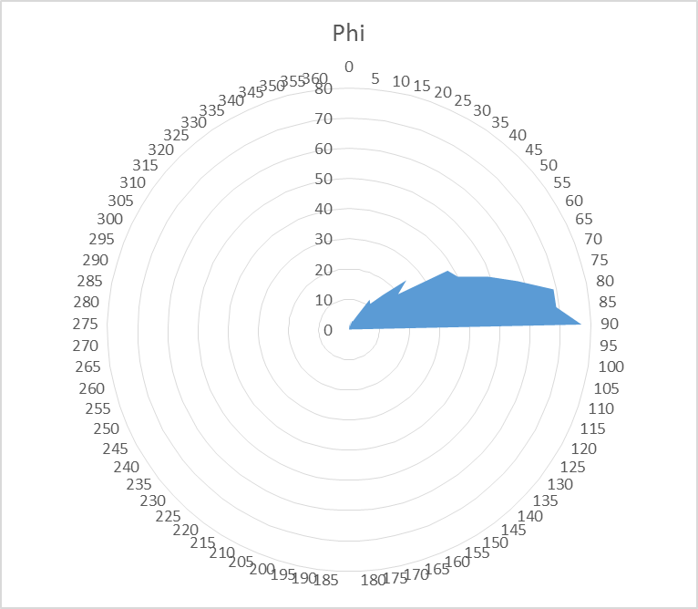
Case: Suaspalo gravel orientations
Gravel samples inside a plastic tube
Traditionally orientation is determined by hand from at least 100 rocks
Tomographic investigation takes a few hours
Orientation determined from thousands of rocks

Slide 13
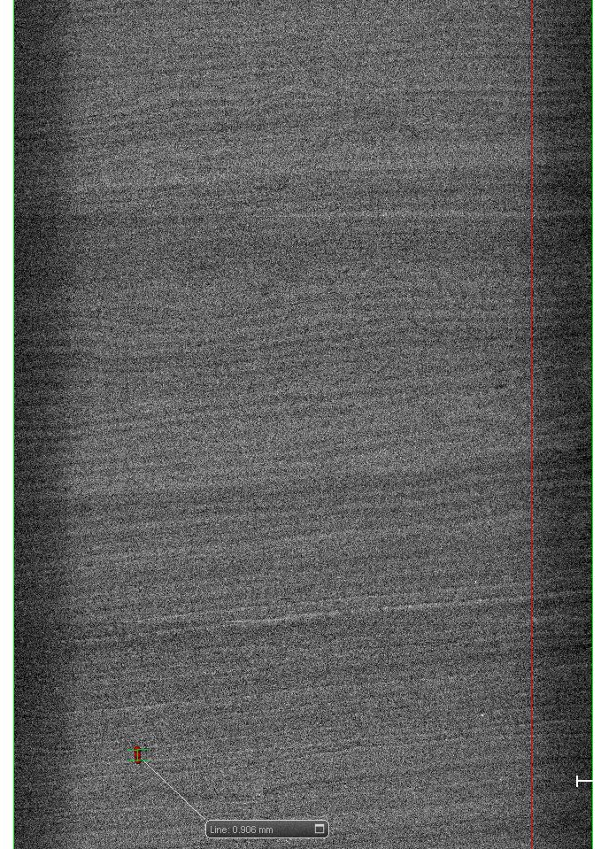
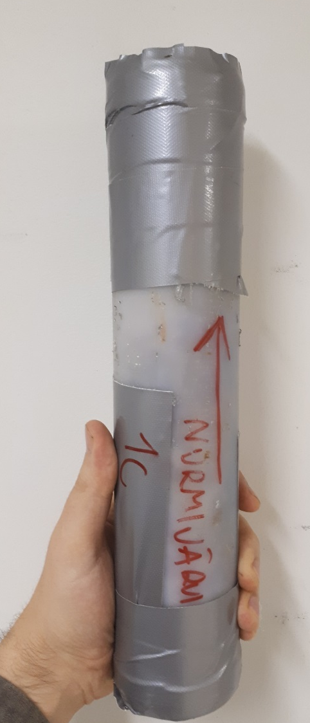
Case: Nurmijärvi lake sediment
Lake sediment samples in a plastic tube
Traditional analysis is manual and time consuming
Tomographic investigation can be done with a rate of 30 cm / h.

Slide 14
What’s ahead?
More users – we want to expand the userbase as much as possible
More sample variety – main focus is on geological samples, but we want to explore the capabilities of the device
Method development, user development – Moving forward through advanced userbase, increased sample variety and networking (FinTomo)
Better tomography

Slide 15
Thank you!

