Slide 1
Geomaterials Research at GTK
Mineral Processing and Materials Research Unit

Slide 2
GTK’s Role in the Research and Innovation Sector
Companies
Product development
Commercialisation
Research services
Applied
research
GTK
Applied research
Geodata
Natural resources
Innovation
ecosystems
APPLICATION OF INFORMATION
Universities
Basic research
Education
Basic
research
COMMERCIALISATION OF INNOVATIONS

Slide 3
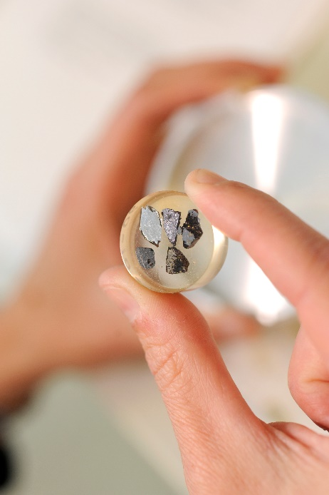
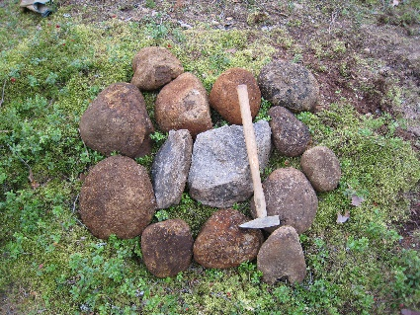
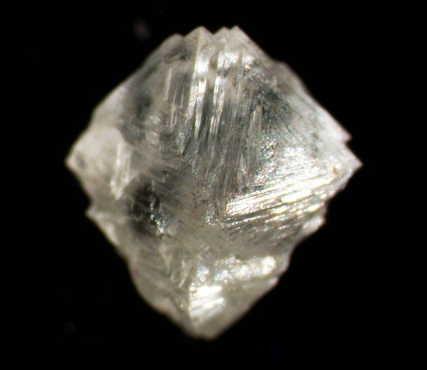
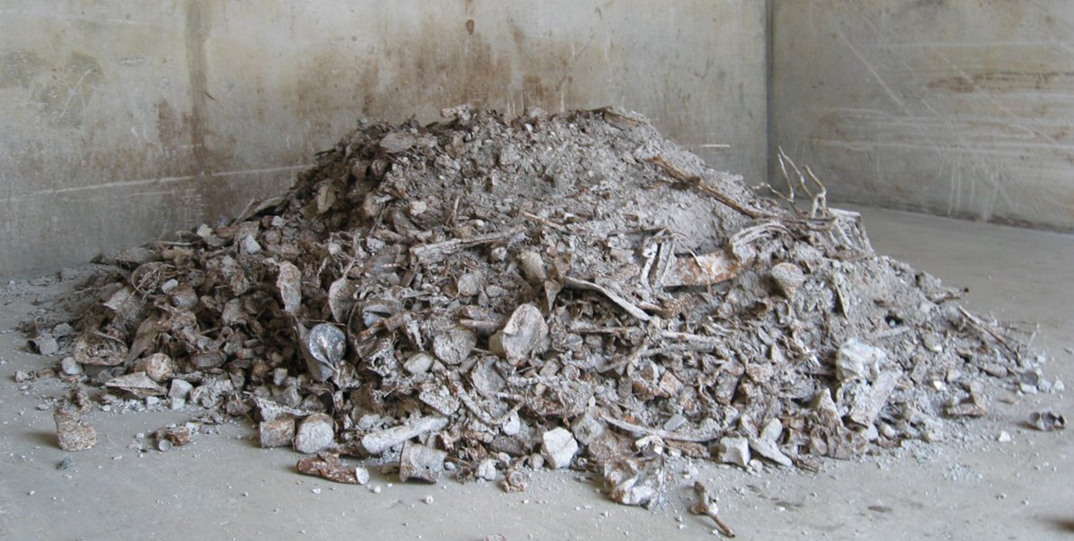
Geomaterials: Definition
Primary and secondary raw materials
All mineral based materials
Naturally occurring
Rocks, sediments and soils
Refined, processed, manufactured and recycled materials
Cement, concrete, slag
Photo: Kari A. Kinnunen

Slide 4
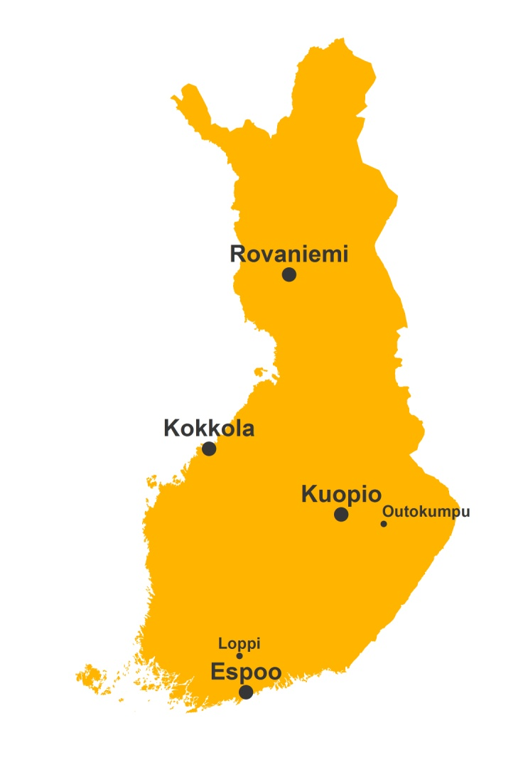
GTK Offices and Units
Geoenergy
Engineering Geology and Land Use
Subsurface Construction and Waste Disposal
Environmental Geology
Marine Geology
Ore Geology and Mineral Economics
Mineral Resources
Industrial Minerals
Mineral Processing and Materials Research (MMA)
Peat Resources
Groundwater
Applied Geophysics
Industrial Environments and Recycling
Regional Geodata and Interpretation
Corporate Geodata Management
Digital Products and Services

Slide 5
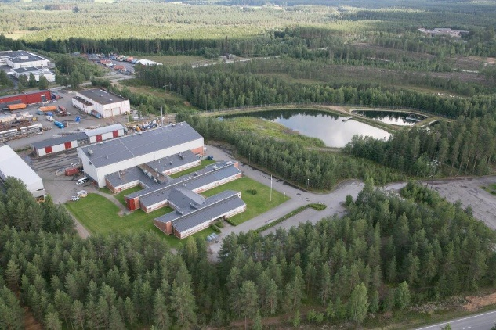
Mineral Processing and Materials Research Unit
Mintec, Outokumpu
Pilot plant
Mineral processing laboratory
Mineralogical laboratory
Staff ca 35
Research Laboratory, Espoo
Mineralogical laboratory
Isotope geology laboratory
Staff ca 20
Risto Pietilä, Head of Unit

Slide 6
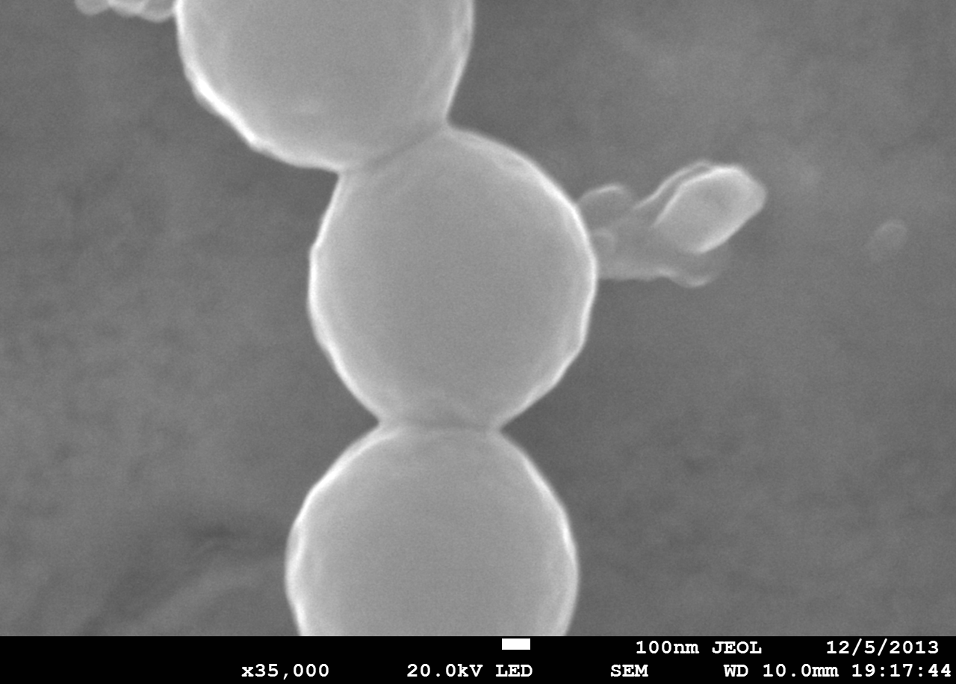
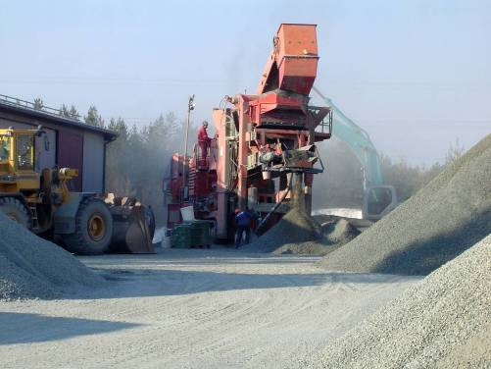
Advanced mineralogical and materials characterization
from nanoscale to kilotons
Entire research chain from nanoparticles to micron scale major, trace and isotope compositional studies to bench top scale method testing to tens or hundreds of tons pilot scale work for proof of concept. Long experience with different kinds of ore types including base metals, precious metals, industrial minerals, rare earth elements and diamonds.
Mineralogical research
• Process samples, ore deposits, secondary and recycled materials
• State-of-the-art techniques MLA, FE-SEM, EPMA, XRD, XCT
Isotope geology research
• Nearly all types of samples, solids and liquids
• State-of-the-art techniques SC-ICP-MS, MC-ICP-MS
Bench scale tests
• All common beneficiation methods
Mini-pilot tests
• Feed capacity range 10-50 kg/h
• Typical sample size 400 – 2000 kg
Pilot plant tests
• Feed capacity range 0,2 – 5 tons/h
• Typical sample size 20 – 300 tons (max 15 000 tons)

Slide 7
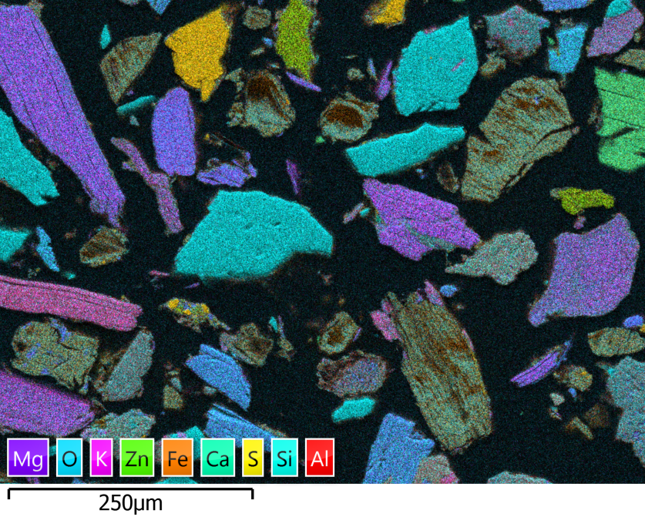
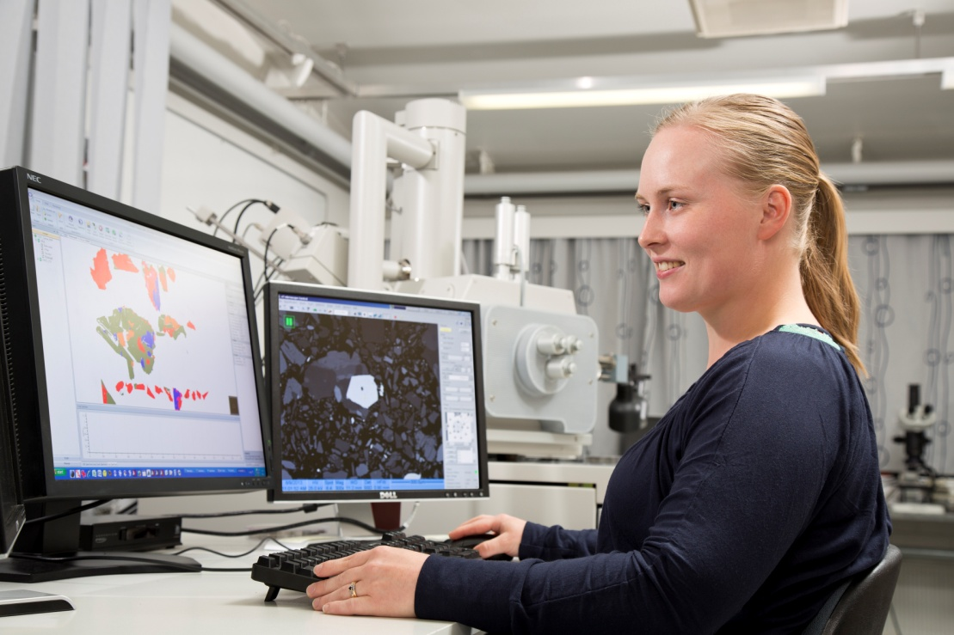
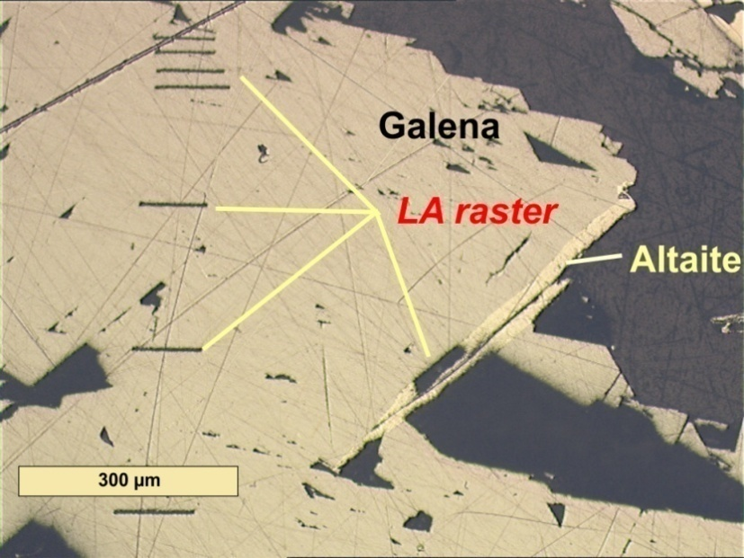
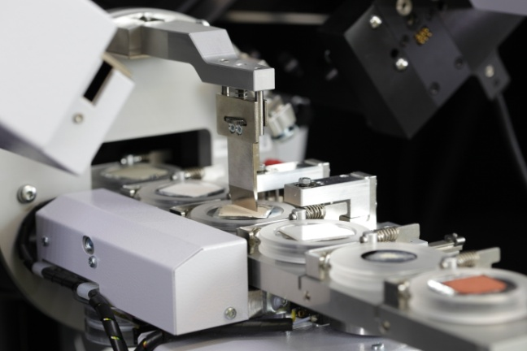
3D characterization
Electron optics - X-ray diffraction - Radiogenic isotopes - X-ray tomography - Selective fragmentation
New research applications: Multidisciplinary approach
Value adding: Collaboration with universities and other research organizations
Expertise and laboratory knowhow to benefit the Client: Processes, materials, products, technologies

Slide 8
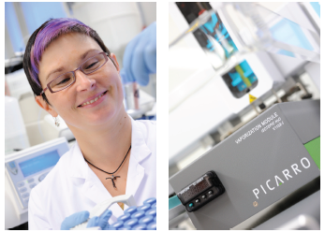
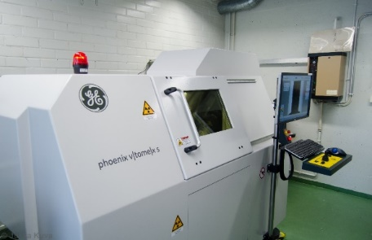
Mineralogy and Isotope Geology Laboratories
Espoo
XRD: mineral identification, clay structural studies
LV-SEM-EDS and FE-SEM-EDS: high resolution imaging, automated mineralogy
EPMA: quantitative major and minor elements
selFrag: High voltage pulse power for selective fragmentation
(LA)-MC-ICP-MS: High precision radiogenic isotopes in solutions and in solids
(LA)-SC-ICP-MS: Trace elements to ppt LOD in solutions and ppb LOD in solids
Automated ion chromatograph for cations
Cavity ring-down spectroscopy system: Stable isotopes on water
High energy microCT scanner: 3D scanning of solids
Mineral separation and clean chemistry laboratories & technical facilities for sample preparation
Outokumpu
XRD: mineral identification
MLA and FE-SEM-MLA/QEMSCAN: high resolution imaging, advanced process mineralogy
Technical facilities for sample preparation
New in 2018: Raman microscope

Slide 9
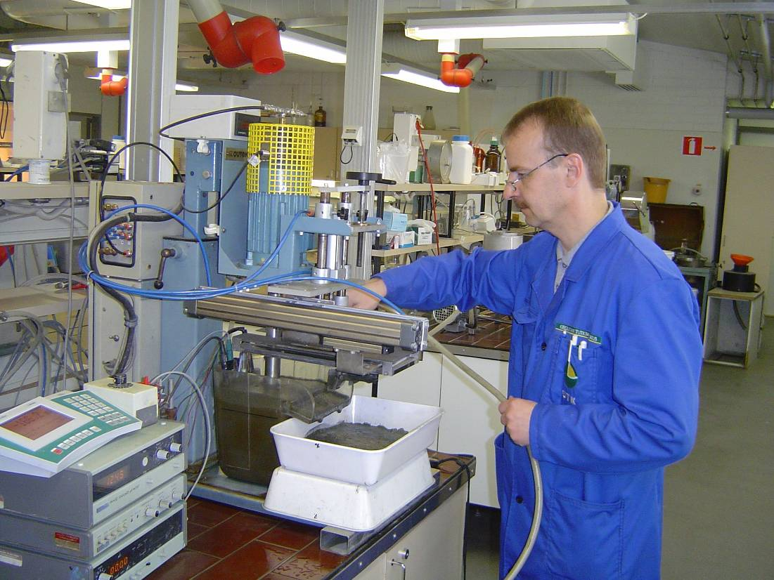
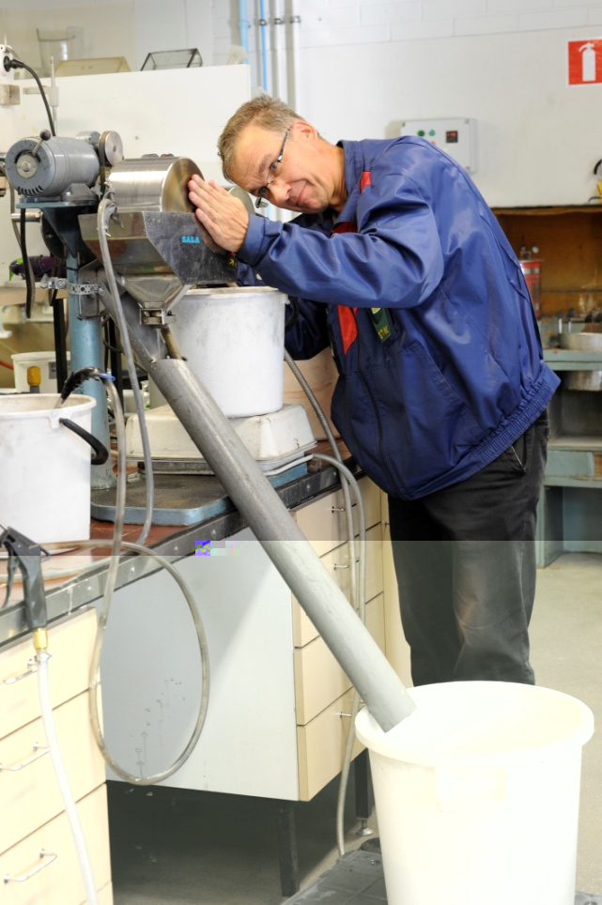
Mineral Processing at Bench Scale
Comminution and classification
Flotation
Hydrometallurgy
Magnetic separation
Gravity separation
Dewatering
Process chemistry

Slide 10
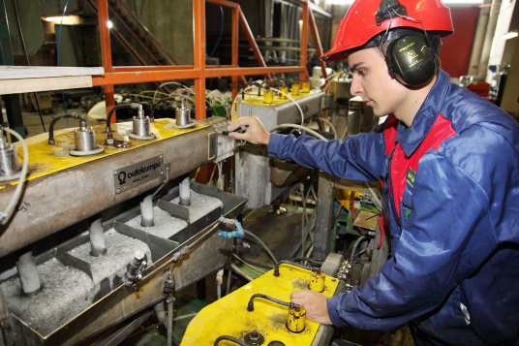
Mini Pilot Plant
First study in a continuous process after bench scale results
Sample size 400 – 2,000 kg drill cores, ore sample etc.
Sample pre-crushed to feed size of 3 - 6 mm
Facility was originally designed and constructed in a sea container
Feed capacity 10 - 50 kg/h

Slide 11
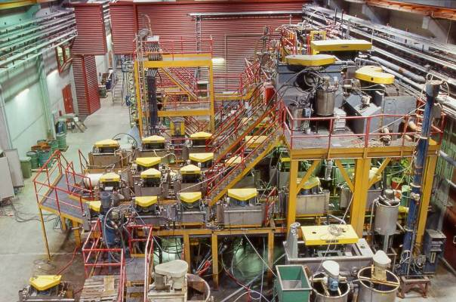
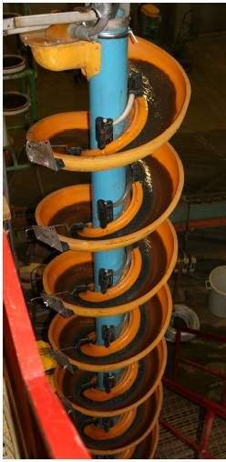
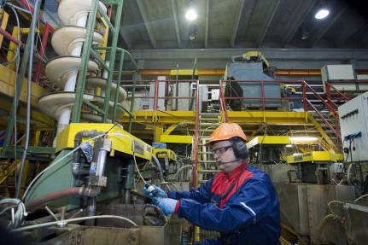
Pilot Plant
Processes can easily be adapted to capacity ranges from 0.2 tph up to 5 tph
Sample sizes typically from 20 to 300 tonnes (max > 15 000 tonnes)
Plant automation and process control of a high level, together with automatic sampling systems, ensure the highest quality results
To conduct testwork for feasibility studies of new ore deposits
To conduct process development for existing plants
To develop comminution and benefication methods, and equipment for industry
To generate process information for plant design
Bankable feasibility studies

Slide 12
Networks
OREVAL, EIT Raw Materials
Network of mineralogical laboratories with complementary know-how for advanced geomaterials characterization
METNET, EIT Raw Materials
European Pilot Plant Network for Extractive Metallurgy and Mineral Processing
PROMETIA
An international non-profit association promoting innovation in mineral processing and extractive metallurgy for mining and recycling of raw materials.

Slide 13
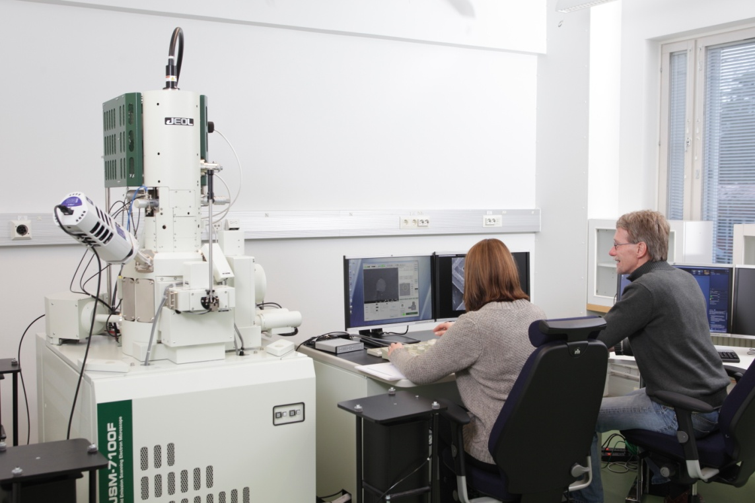
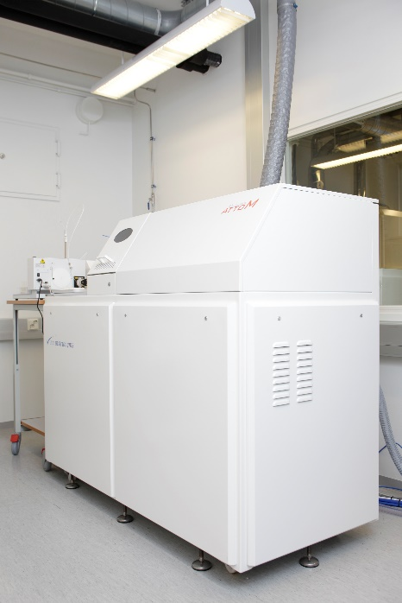
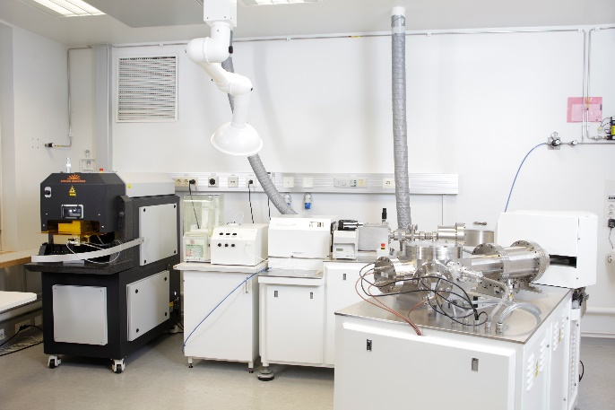
Suomen Geotieteiden Tutkimuslaboratorio (SGL)
Finland Geosciences Research Laboratory (SGL)
Geological Survey of Finland (GTK) • Aalto University • University of Helsinki • University of Turku • Åbo Akademi University • University of Oulu
Field Emission (High Resolution) Scanning Electron Microscope
Single Collector High Resolution Inductively Coupled Plasma Mass Spectrometer
Multi-Collector High Resolution Inductively Coupled Plasma Mass Spectrometer
2016: 19 peer-reviewed articles

Slide 14
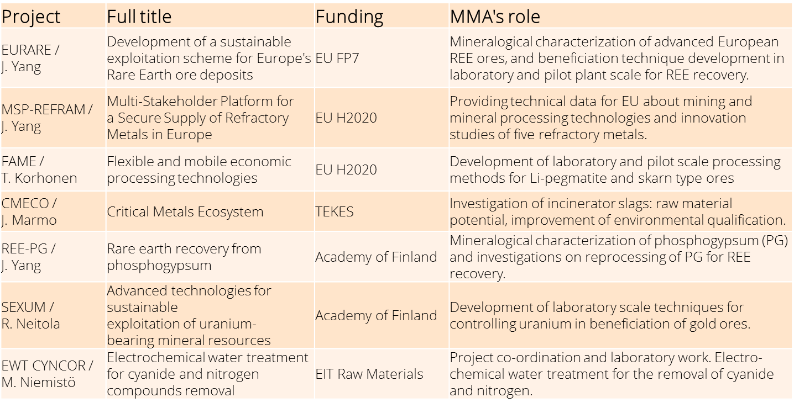
MMA: Current Research Projects

Slide 15
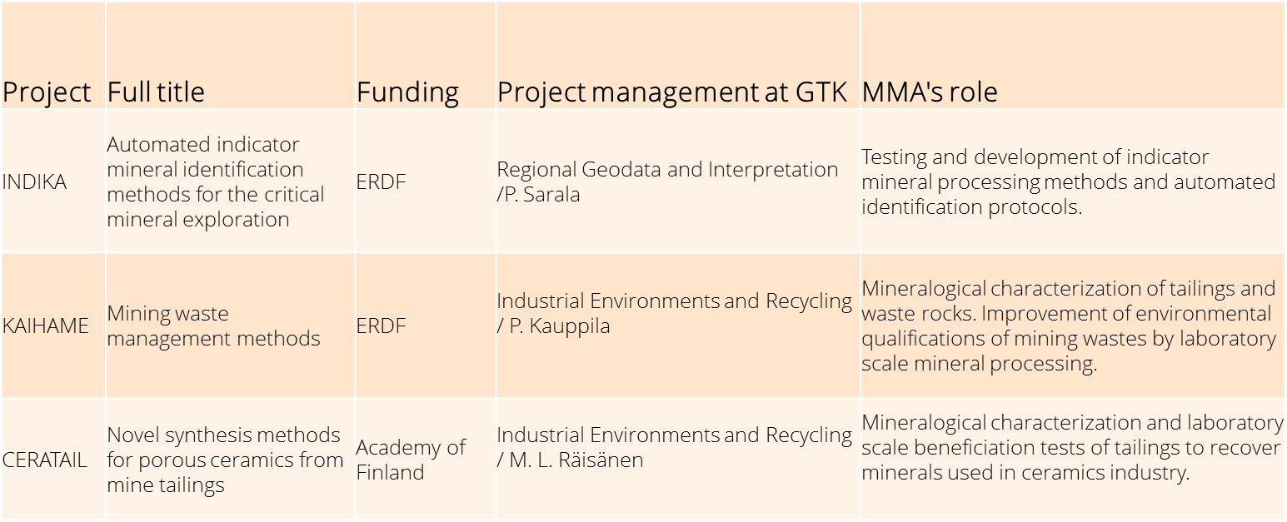
Current Research Projects: Jointly with other GTK Units

Slide 16
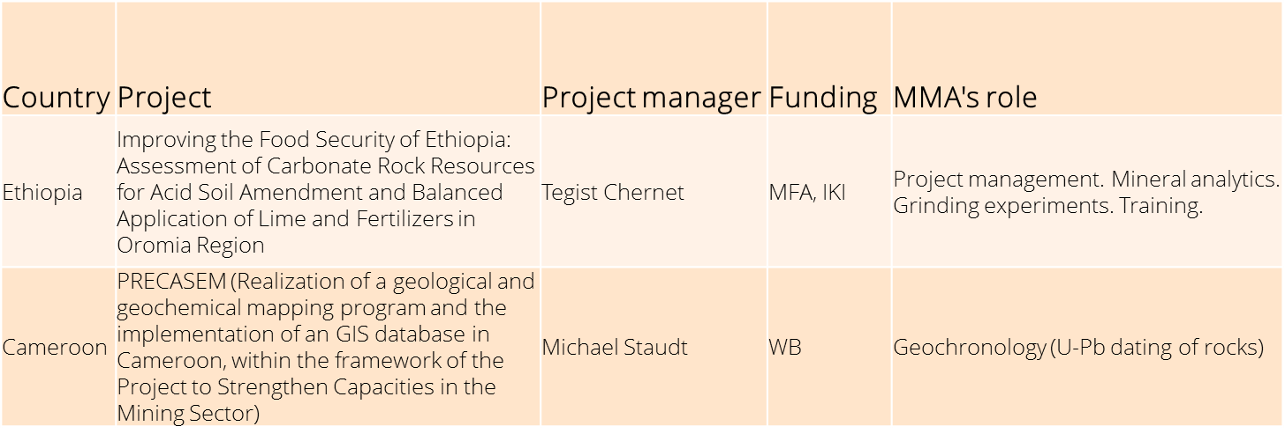
Foreign Projects

Slide 17
Thank you for your attention!
Kiitos!

