Slide 1
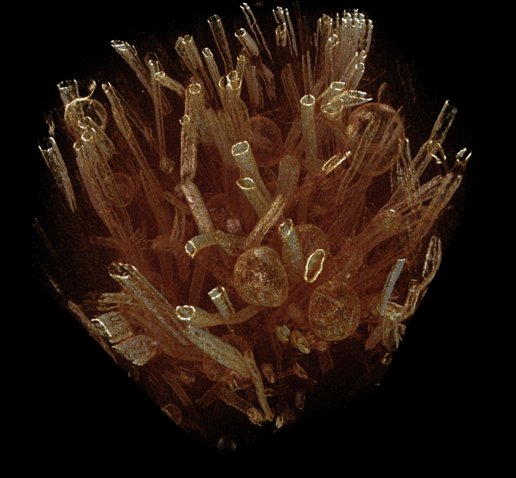
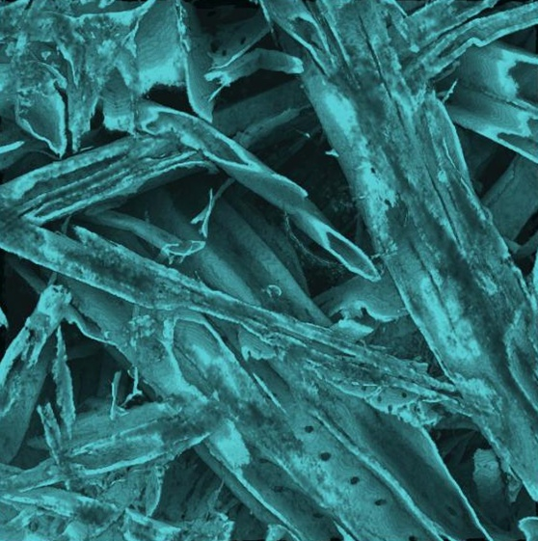
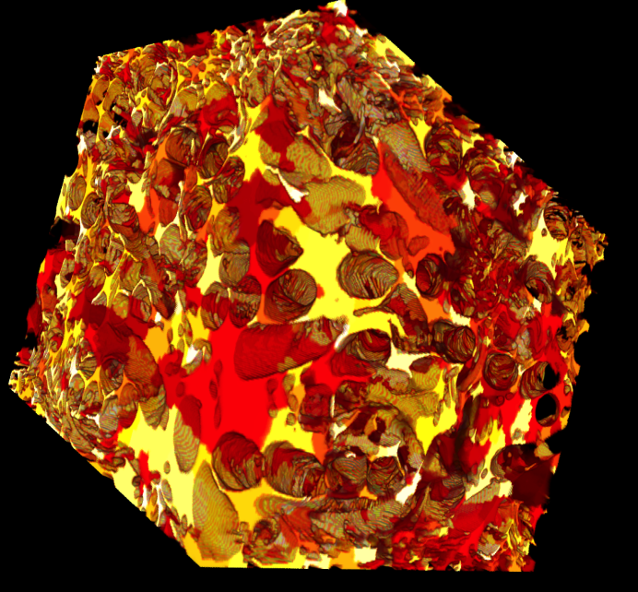
X-ray Tomography. collaboration, perspectives, visions?
Markku Kataja
X-ray Tomography Laboratory,
University of Jyväskylä, Department of Physics

Slide 2
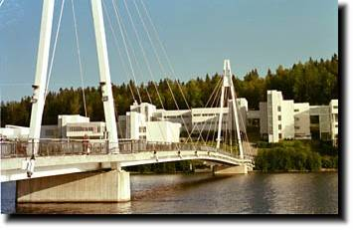
University of Jyväskylä, Department of physics (JYFL)
Main fields of research:
• Subatomaric physics
- Nuclear physics (Accelerator laboratory)
- Particle physics and cosmology
• Materials physics
- Nanophysics (Nanoscience centre)
- Complex materials (X-ray tomography lab.)

Slide 3
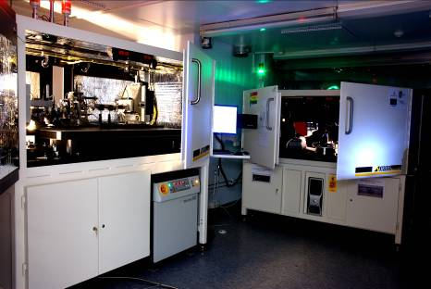
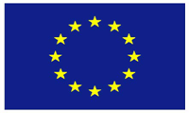


JYFL X-ray Tomography Laboratory. Facilites
1. Zeiss Xradia multiscale equipment.
Micro/nanotomography
Resolution 30 µm - 50 nm
Sample size 40 mm - 15 µm

Slide 4
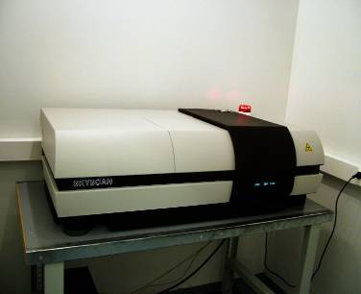
JYFL X-ray Tomography Laboratory. Facilites
2. SkyScan 1172 table-top scanner.
Resolution 30 µm - 5 µm
Sample size 50 mm - 2 mm
10 MB camera

Slide 5
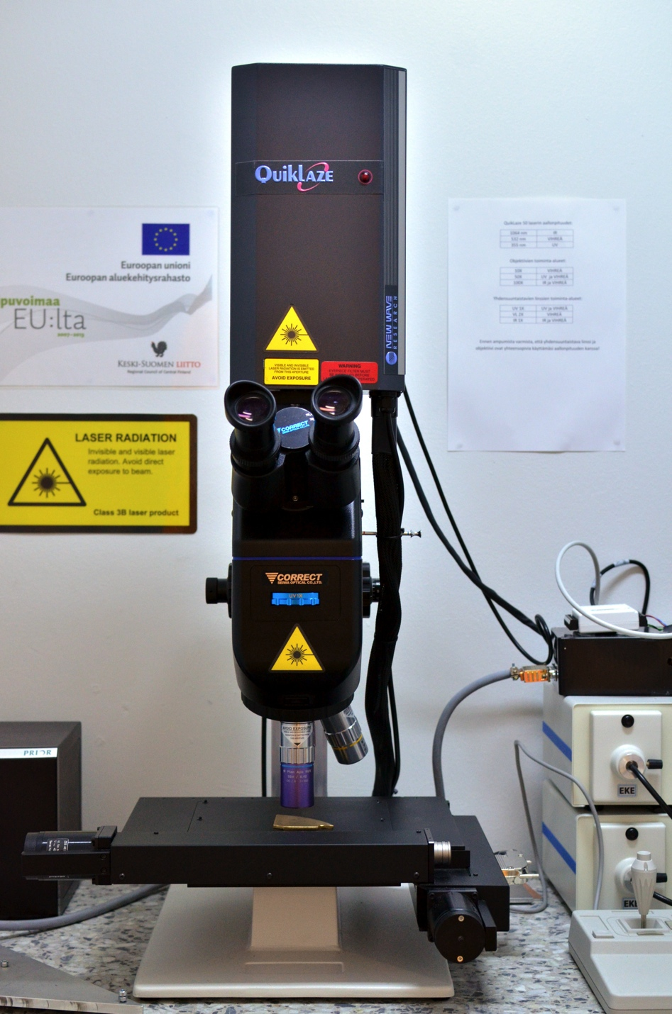
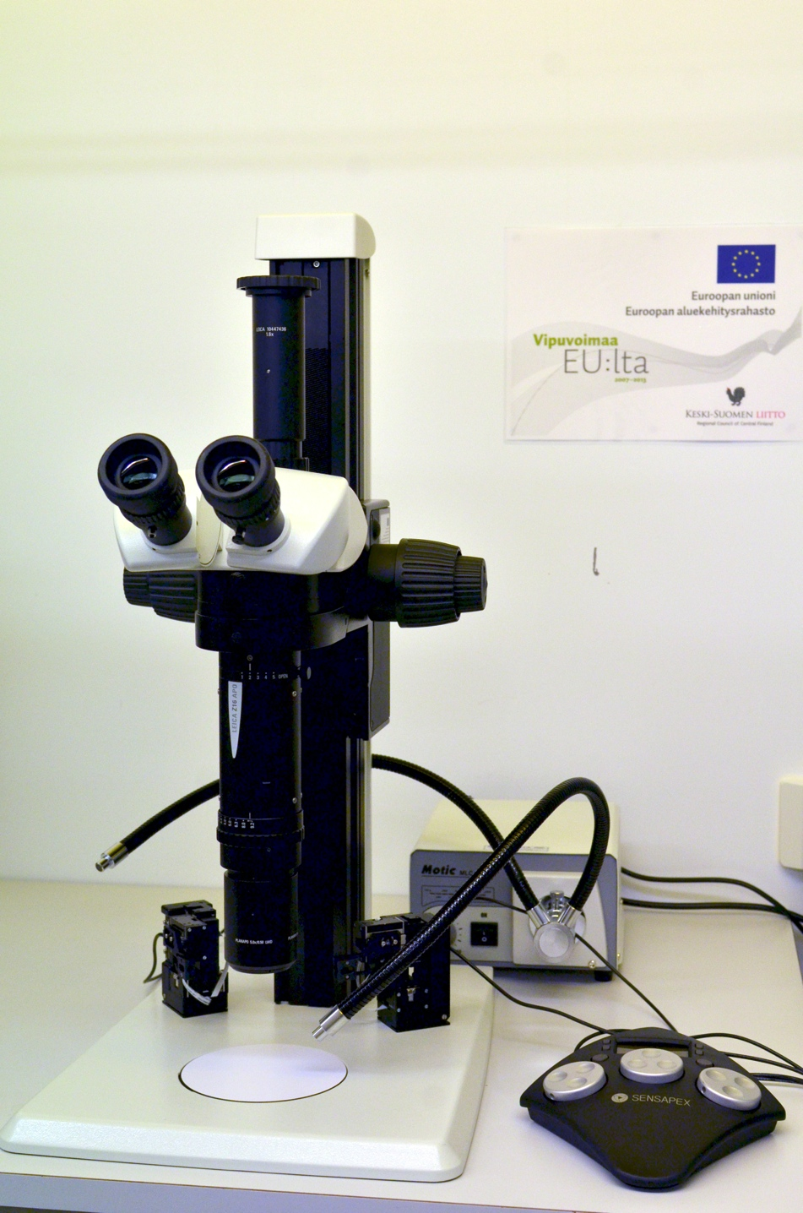
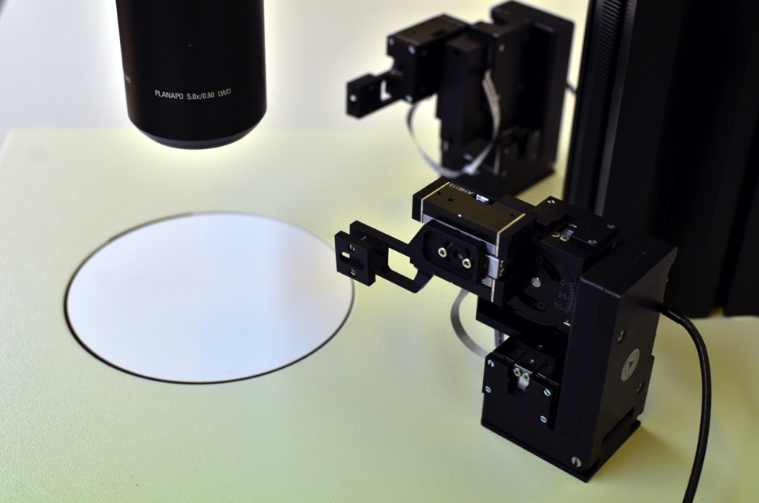
Facilities
3. Sample preparation equipment
Precision laser machining tool
Stereo microscope with micromanipulators

Slide 6
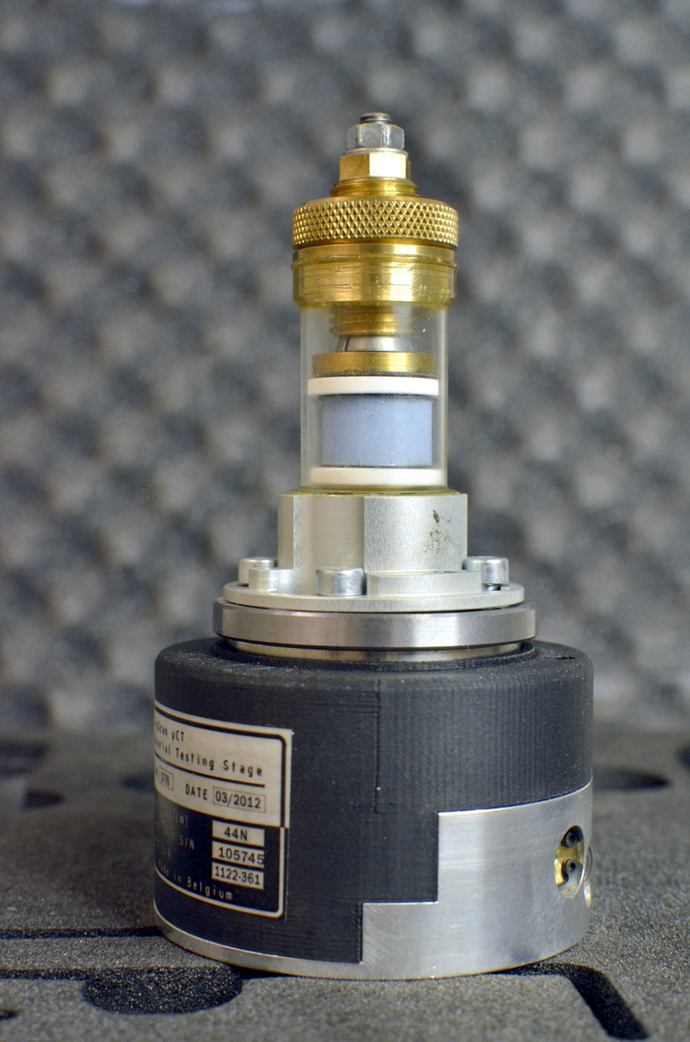
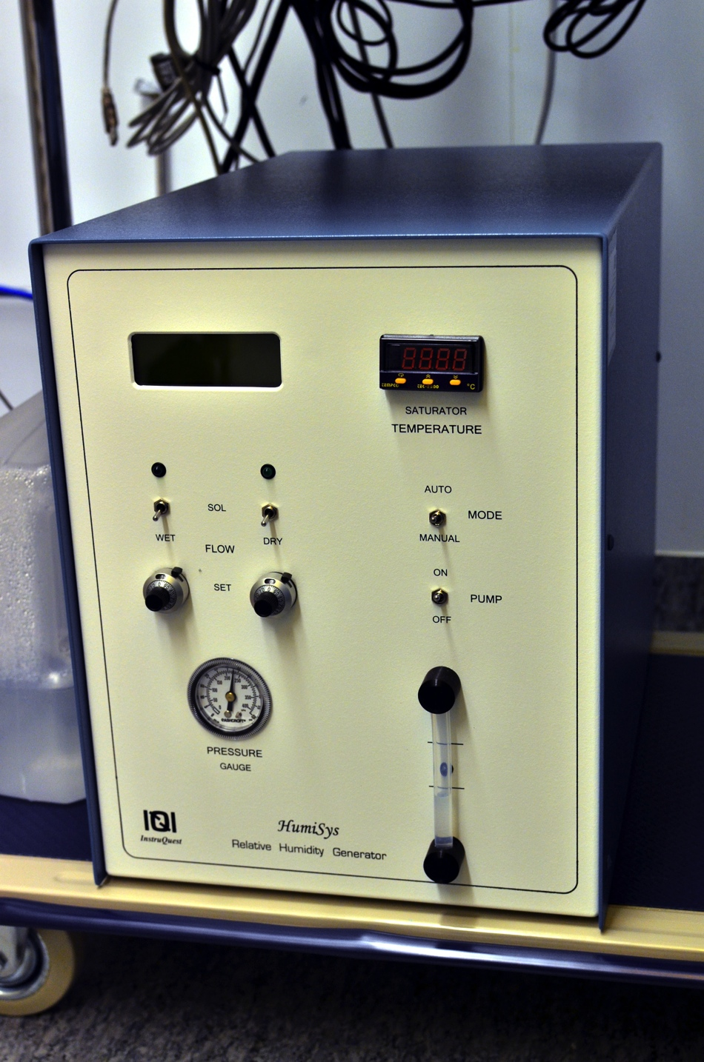
Facilities
4. Sample conditioning equipment
Mechanical sample straining unit
Humidity controller

Slide 7
Research profile: Complex materials group
X-Ray tomographic imaging and image analysis
Non-destructive 3D imaging of material samples even in nm scale
Structure and transport phenomena of heterogeneous materials
Image analysis methods development
Heterogeneous materials research
Structural properties
Transport properties (4D imaging)
Composites, biological materials, geological materials,...
Hydromechanical behaviour of bentonite
Modelling and simulation
Flow in porous media
Transport phenomena
Multiphase flows
Industrial applications
Bio-based composites
Strength, fracture and barrier properties of various materials

Slide 8
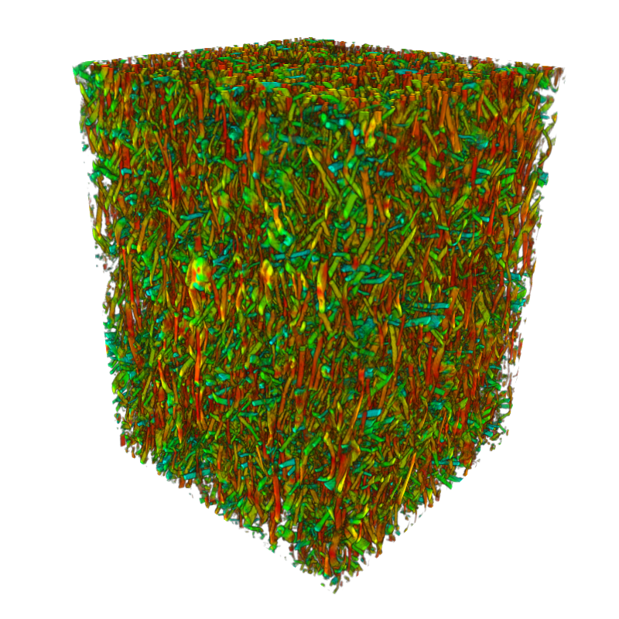
Methods development at JYFL:
General goal: Quantitative measurement of heterogeneous materials properties based on 3D tomographic images.
Image reconstruction
- Filtered back-projection - and beyond
Image post-processing
  Denoising
  Artefact removal
3D image analysis
  Structural characteristics (porosity, surface area,…)
  Pattern recognition (particles, fibres, single pores,…)
  Orientation, sceletonization,…
  …
  Numerical simulations based on true structrure
  Flow properties in porous media
  Orientation, sceletonization,…
  …
  4D tomography
  Monitoring temporal change of internal structure
  E.g.: water transport and deformations in wetting/swelling medium

Slide 9
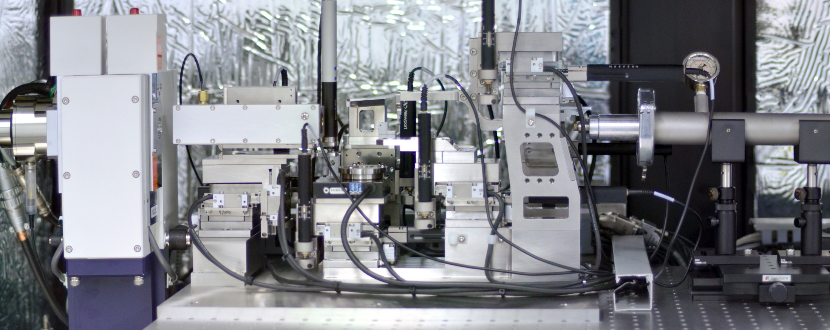
Nanotomography
X-ray source
A copper anode, characteristic peak of 8 keV.
Pinhole
Used to exlude multiple reflected light.
Sample
At focal point
Phase ring
To block direct light (not diffracted by the sample) and to generate zernike phase contrast image.
Condenser
An elliptical capillary lens used to focus X-rays into the sample.
Objective Zone plate
Another focusing optics (Fresnel zone plate) to focus the image onto detector.
Flight tube and detector
He gas filled tube used to channel X-rays to the detector (CCD chip coupled with a scintillator)
Notes:
Alignment työläs
Laitteisto optimoitua siten että mahdollisimman paljon röngenia läpi (efficiency is a problem)

Slide 10
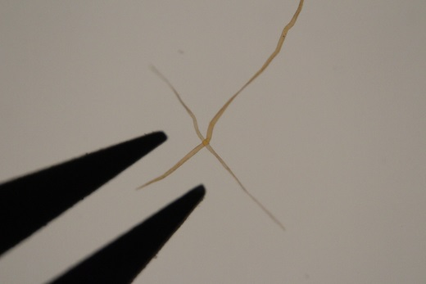
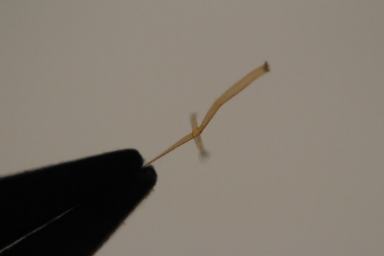
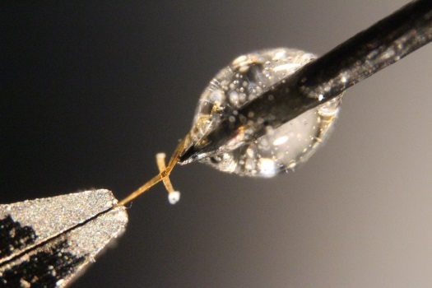
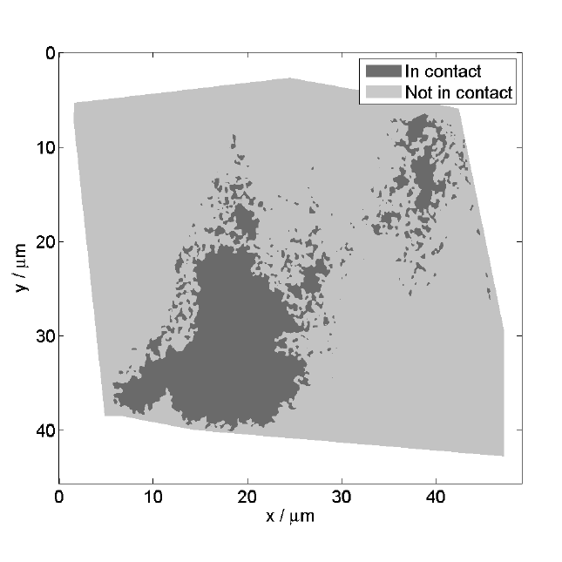
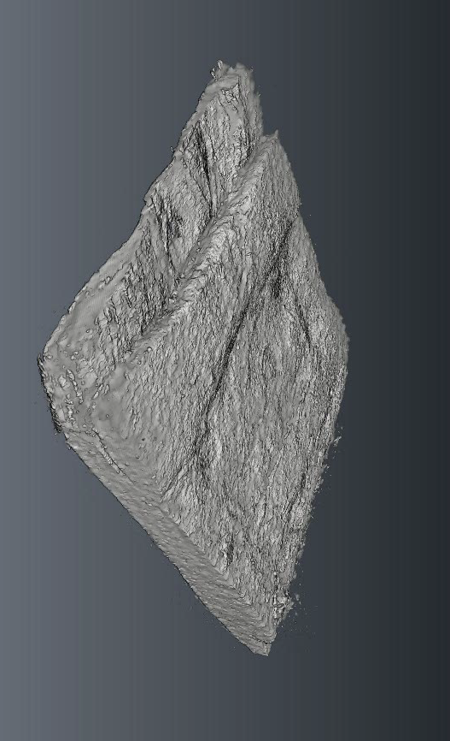
XnCT example: contact between two wood fibres
Sample preparation using micromanipulators and laser cutting
Sample ready for
scanning
Nano-CT image of
the contact
Contact area analysed

Slide 11
Collaborative opportunities
General perspective (FinTomo network)
Joint research projects
- E.g. participation in EU projects
Joint infrastructure projects
- FIRI, EU,...
Subcontracting
- Role as an external service provider in public or industrial projects.
Sheared resources:
- Facilities (device time)
- Expertise
- Knowledge
Researcher training
- PhD student exchange,
- Summerschools,
Mobility
- Post-doctoral researcher exchange
... etc.

Slide 12
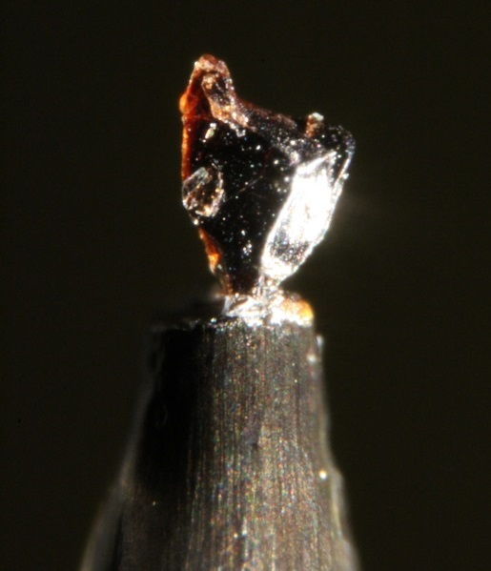
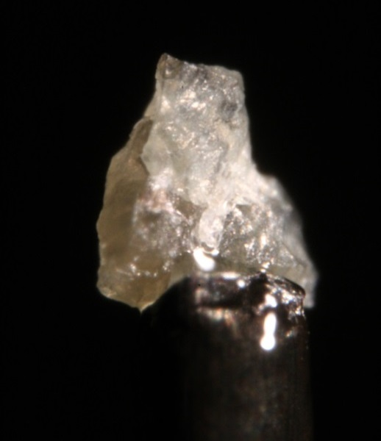
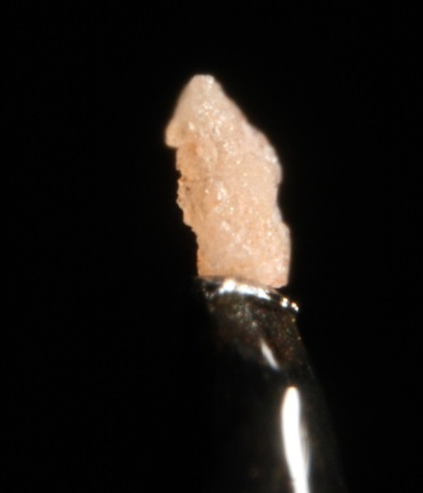
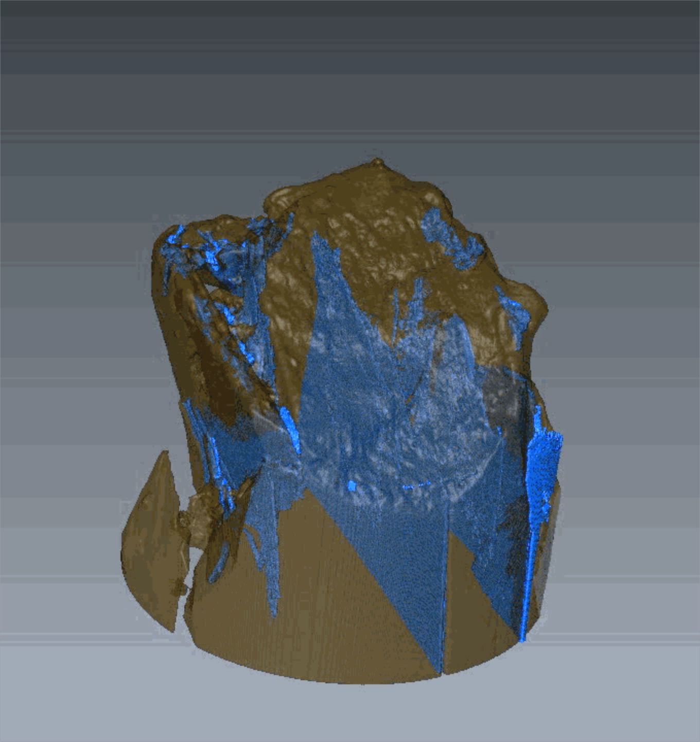
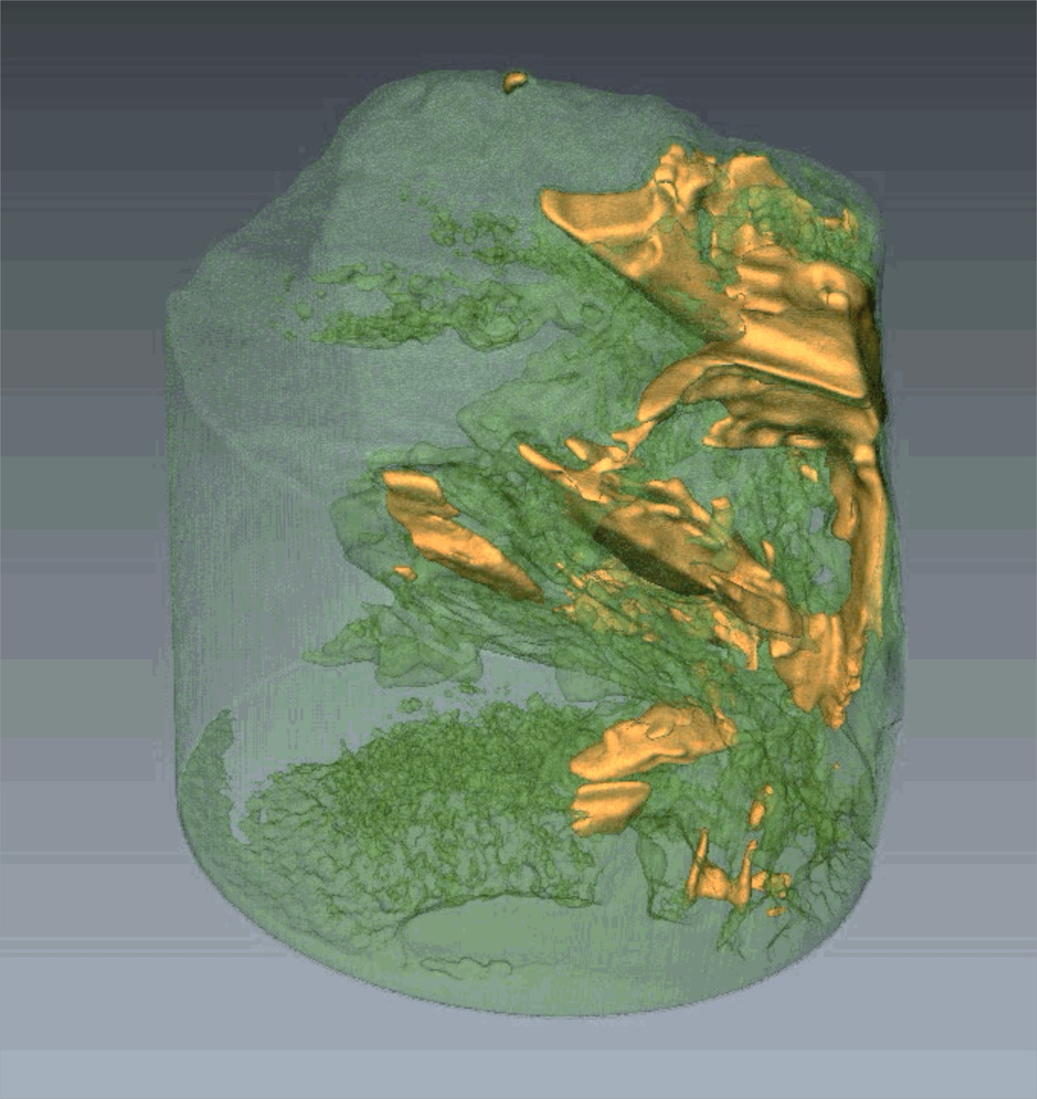
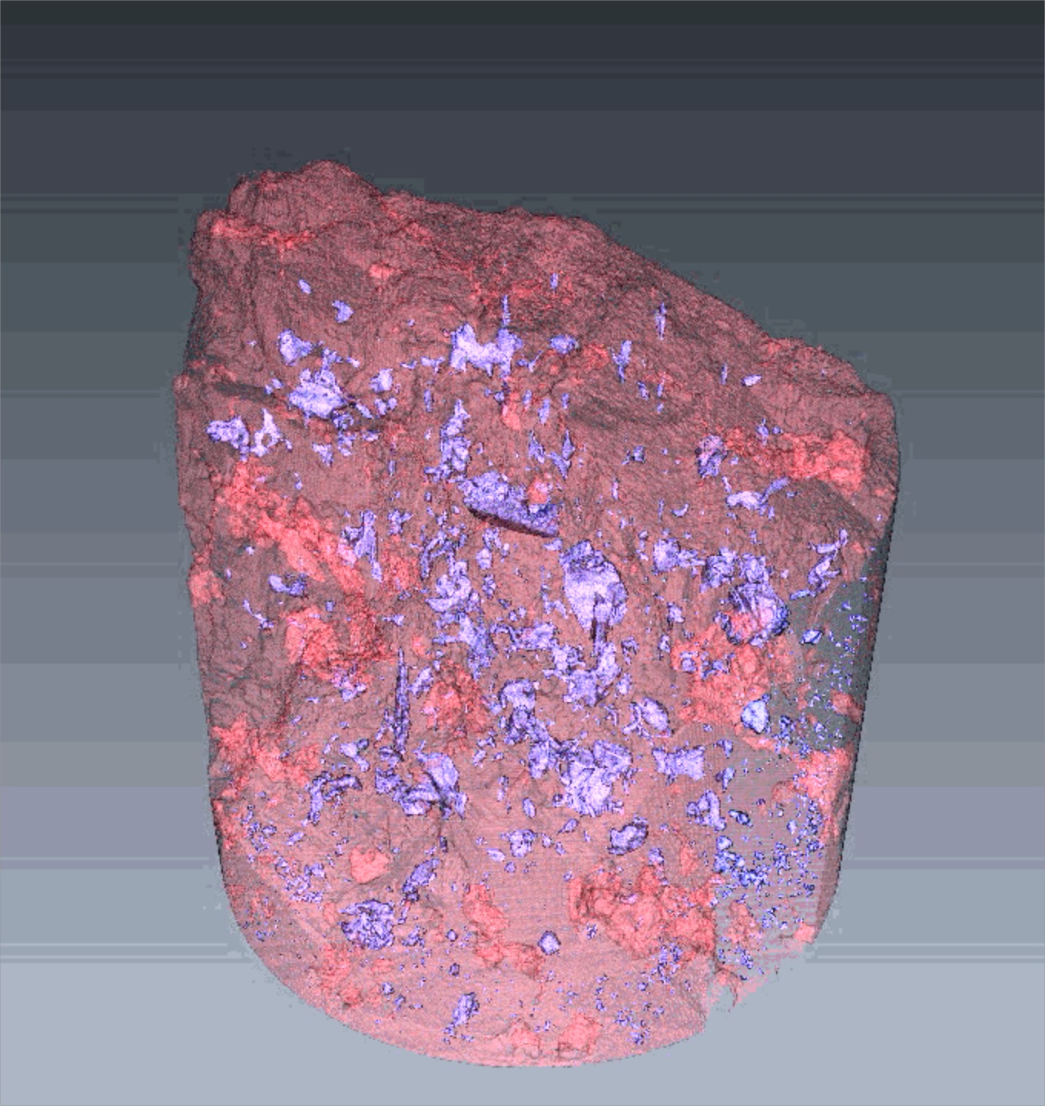
Biotite
Practical example of GTK-JYFL collaboration:
Geological samples imaged with nano-CT.
- FOV 60 μm, Pixel size 65 nm, Resolution 150 nm
Cordierite
Feldspar

Slide 13
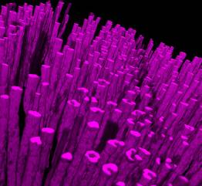
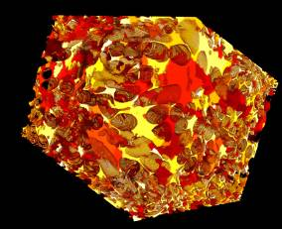
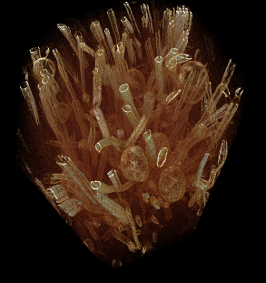
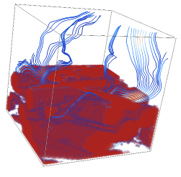
Tomographic art
Pore space of a felt segmented into individual
pores.
Wood fibres in a composite
material
Tracheids of wood
Numerically solved
flowlines in porous
material
Internal structure of cardboard
Minerals in cordierite

