Slide 1
MicroCT at University of Helsinki
Collaborative Visions and Opportunities
GTK X-Ray Tomography Launch Meeting

Slide 2
X-ray SCIENCE at University of HELSINKI
X-ray Laboratory at the Department of Physics
Active unit on X-ray related research, 10 – 20 persons
X-ray method development and X-ray applications
Chemical Composition and Atomic Structure
Diffraction
Scanning micro-beam diffraction
XANES
Microstructure
Micro-CT
In situ / in vivo / in operando imaging
Phase contrast imaging (in development)
Elemental composition
Fluorescence

Slide 3
Examples of Applications at x-ray laboratory
Materials science
Clean energy materials, wood and paper structure
Materials physics
Water properties
Biology and medicine
Evolution-development, pre-clinical studies, plant morphology
Paleontology
Micrometeorites
Soil science

Slide 4
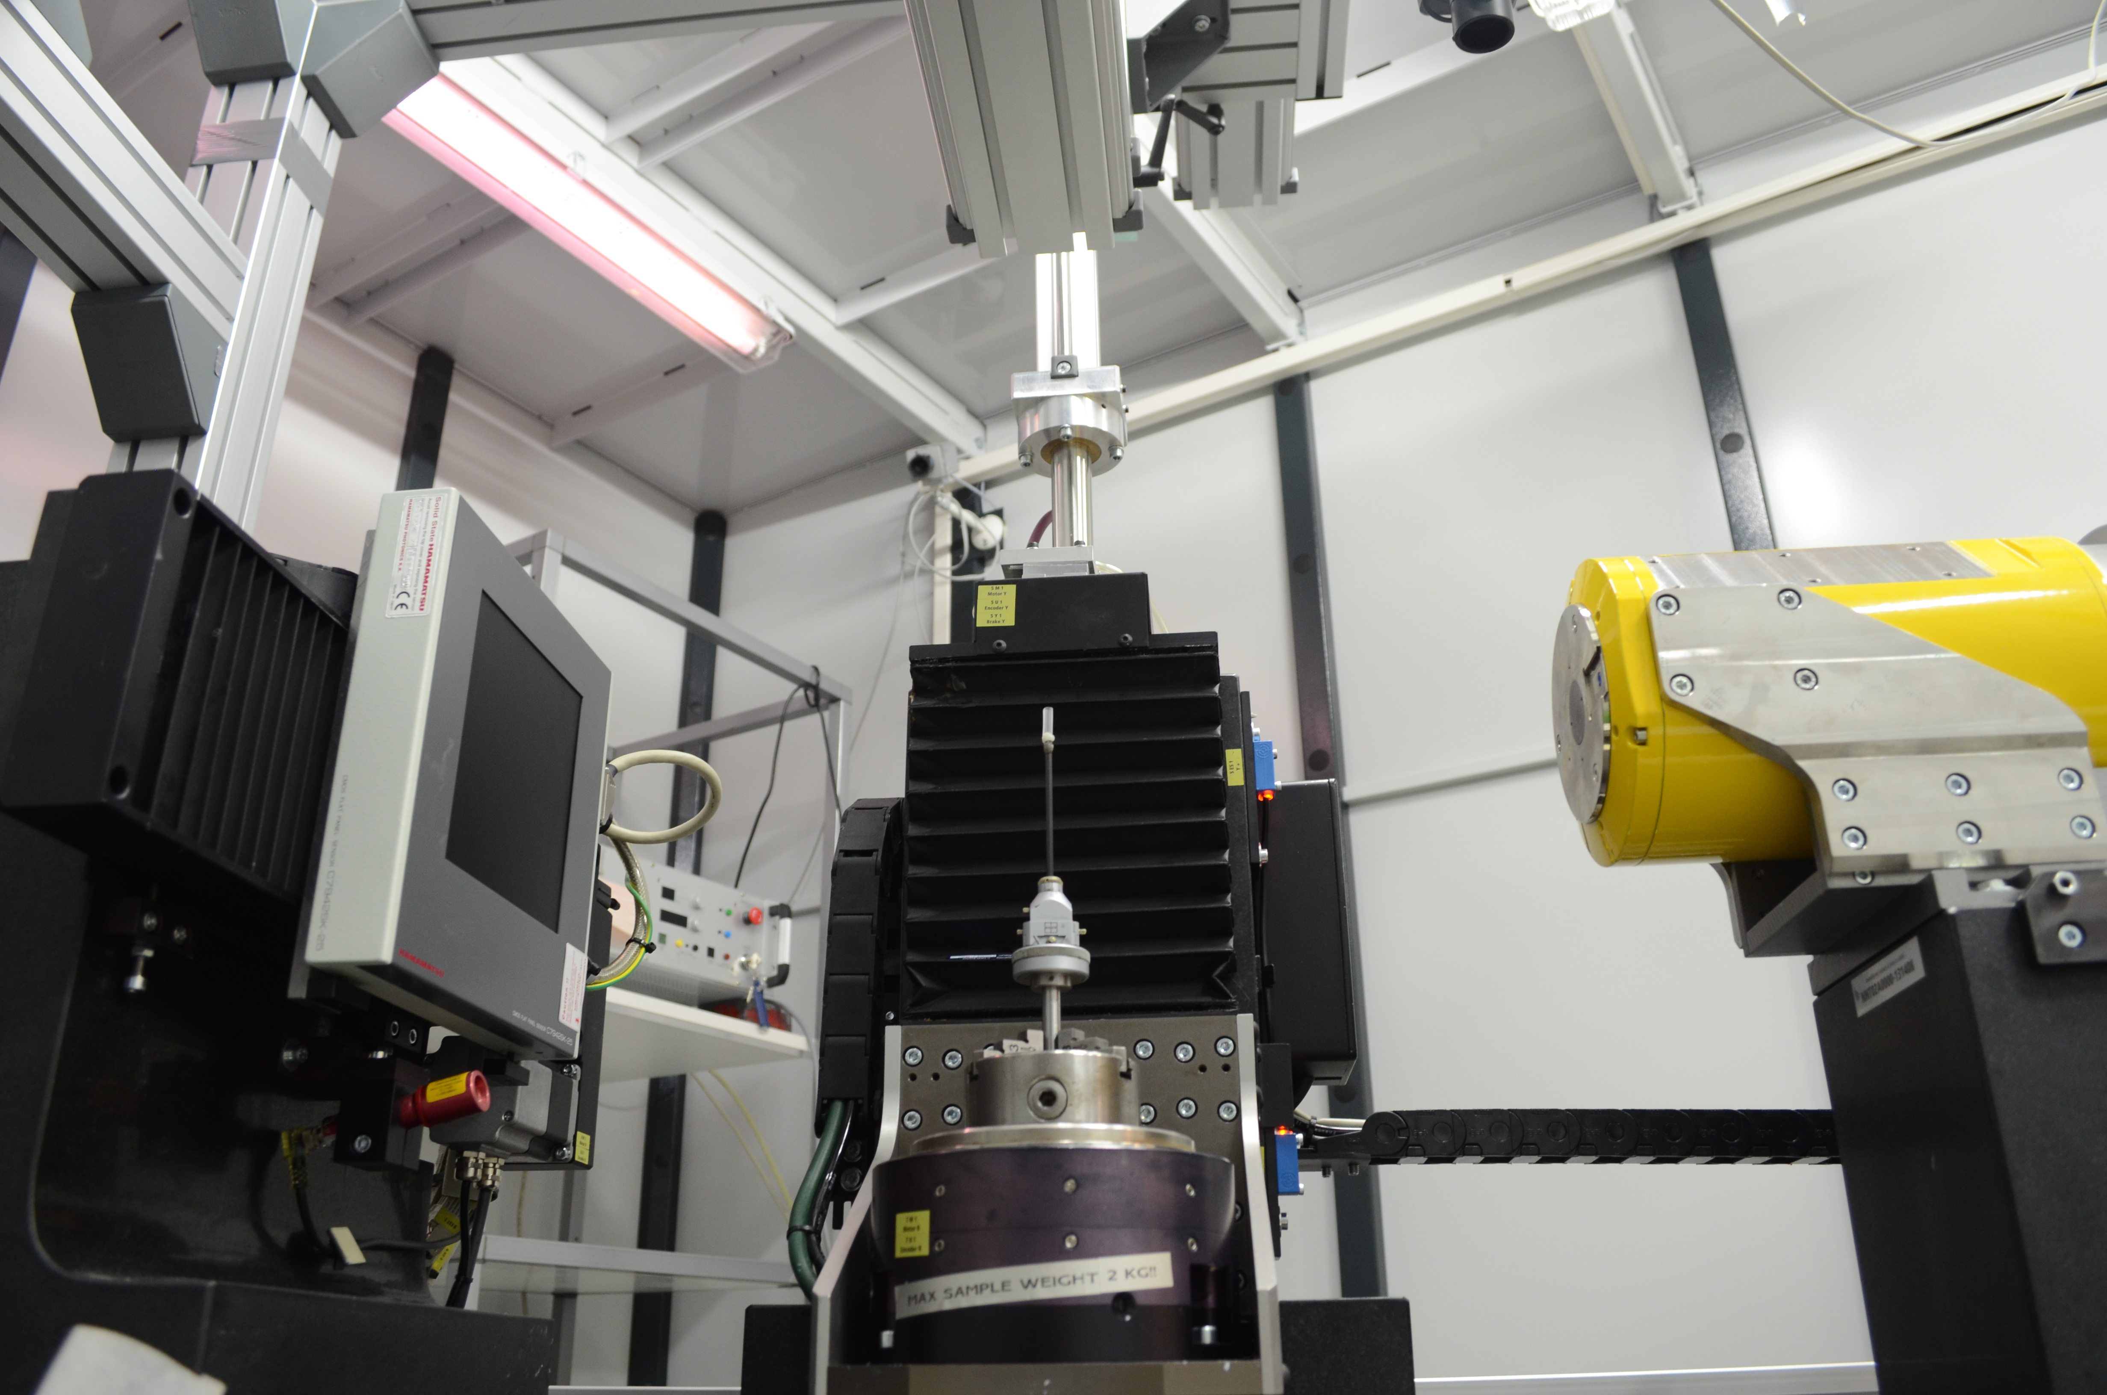
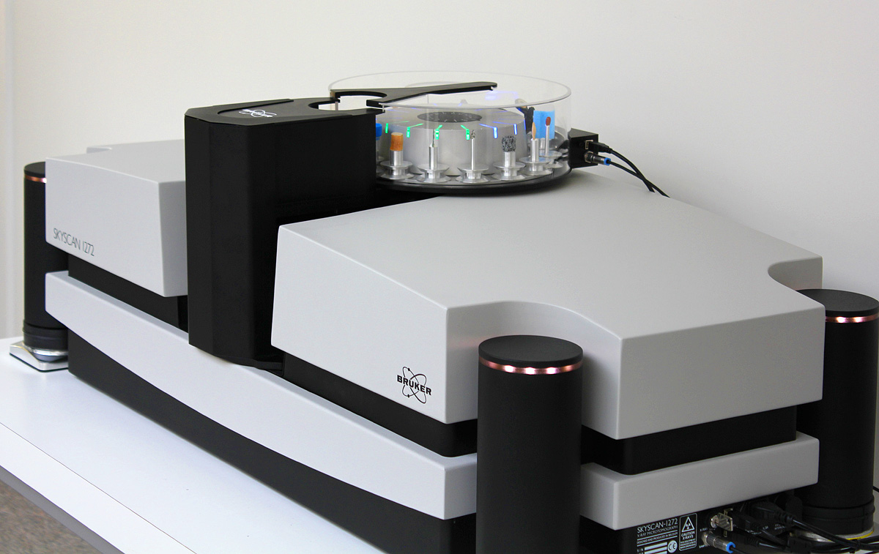
MicroCT Equipment at X-Ray Laboratory
GE nanotom | s
30 kV to 180 kV
Achievable resolution ~1 µm
Allows building of large custom setups
Complemented by X-ray microbeam diffraction → the sample can be characterized from the atomic scale to micron scale in the same setup
Bruker Skyscan 1272
20 kV to 100 kV
Achievable resolution ~1 µm
Automatic sample changer for high throughput
Easy to use with small training
Low maintenance

Slide 5
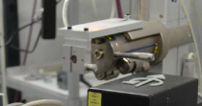
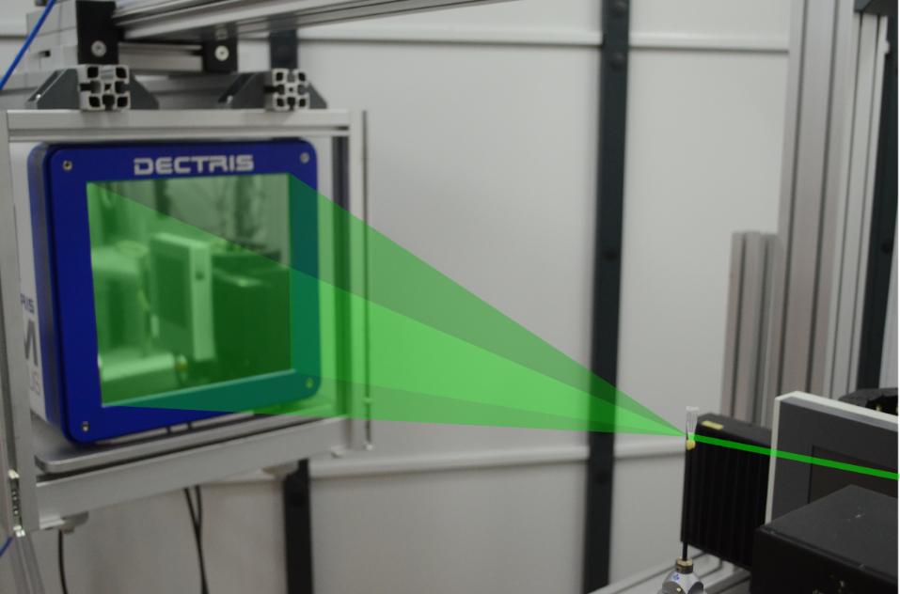
Combining X-ray MicroCT and Micro-Diffraction
Mo-target tube with focusing optic: 100 µm beam at sample, E=17.4 keV, ΔE/E = 10⁻²
Pilatus 1M Detector

Slide 6
Micro-Diffraction Example: bentonite anisotropy (JP Suuronen et al. Applied Clay Science, 101 (2014), doi: 10.1016/j.clay.2014.08.015)
Micro-cracks as seen in µ-CT
X-ray scattering from clay tactoids

Slide 7
LAB + Synchrotrons
Chemical Composition and Atomic Structure
Diffraction
Scanning micro-beam diffraction
XANES
Microstructure
Micro-CT
In situ / in vivo / in operando imaging
Phase contrast imaging (in development)
Elemental composition
Fluorescence
Diffraction imaging
Scanning diffraction with nano-probe
RIXS, nRIXS
Time-resolved studies
nano-CT with phase contrast or coherent imaging
Ultra-fast imaging (sub-µs 2D images, 100 ms 3D images)
Micro-probe and nano-probe for scanning fluorescence
K-edge subtraction imaging

Slide 8
Collaborative VISIONS
Having more µCT machines is good for for Finnish researchers. How can we maximize the potential for good research outcomes?
Complementary research profiles
Combining efforts for problem solving
Combining efforts for new developments:
In situ device design and implementation
Developments in quantitative imaging and elementally sensitive imaging
Joint µCT workshops
Joint applications for infrastructure funding, e.g. compact source

Slide 9
Collaborative VISIONS
At University of Helsinki X-ray Laboratory we can help you in your studies in the following ways:
To go beyond basic µCT
Combination of µCT and diffraction
Complementary analysis with XANES and fluorescence
To have high throughput µCT for large sets of similar samples
To develop and use in situ rigs for imaging
To do advanced studies with synchrotron radiation
Understanding of fundamental physics for materials

Slide 10
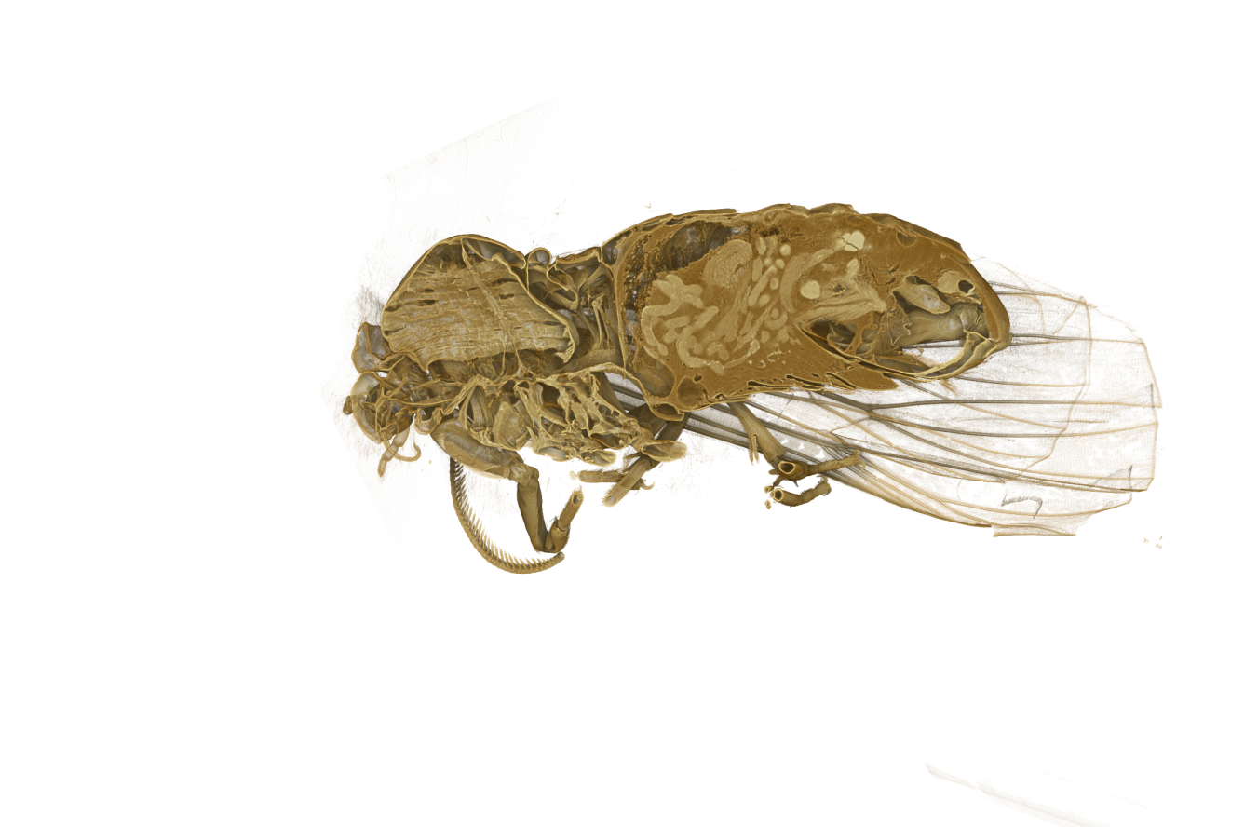
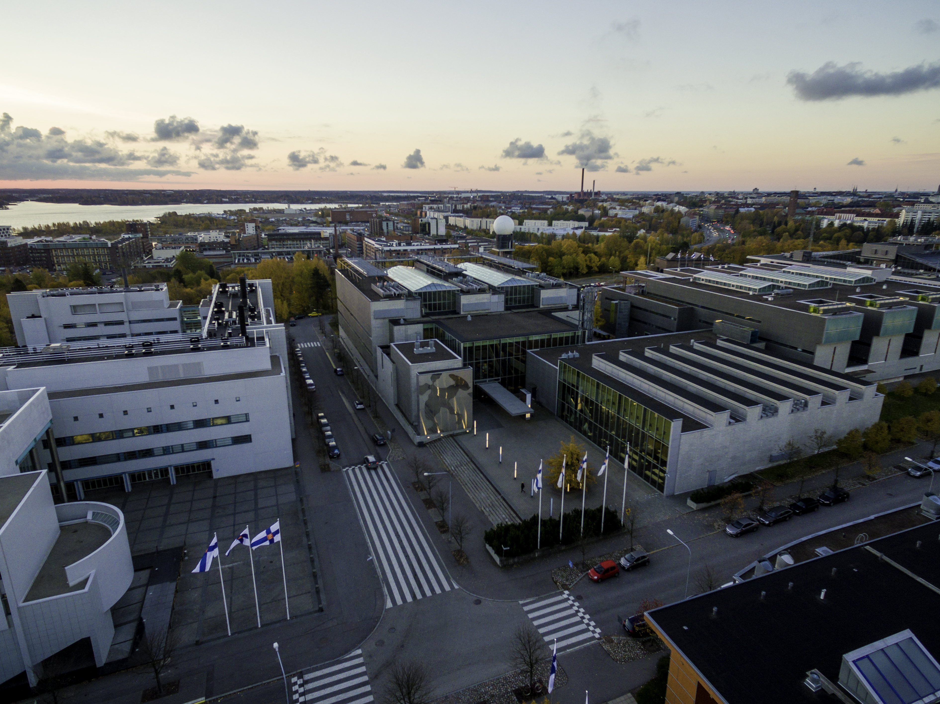
Contact US for More Details
blogs.helsinki.fi/micro-ct
www.xraylab.fi
heikki.suhonen@helsinki.fi

